Slide 1
Sutton & Barto, Chapter 4
Dynamic Programming

Slide 2
Programming Assignments?
Course Discussions?

Slide 3
Review:
V, V*
Q, Q*
π, π*
Bellman Equation vs. Update

Slide 4
Solutions Given a Model
Finite MDPs
Exploration / Exploitation?
Where would Dynamic Programming be used?

Slide 5
“DP may not be practical for very large problems...” & “For the largest problems, only DP methods are feasible”
Curse of Dimensionality
Bootstrapping
Memoization (Dmitry)

Slide 6
Value Function
Existence and uniqueness guaranteed when
γ < 1 or
eventual termination is guaranteed from all states under π

Slide 7
Policy Evaluation: Value Iteration
Iterative Policy Evaluation
Full backup: go through each state and consider each possible subsequent state
Two copies of V or “in place” backup?

Slide 8
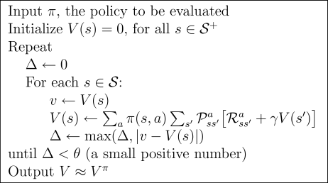
Policy Evaluation: Algorithm

Slide 9
Policy Improvement
Update policy so that action for each state maximizes V(s’)
For each state, π’(s)=?

Slide 10
Policy Improvement
Update policy so that action for each state maximizes V(s’)
For each state, π’(s)=?

Slide 11
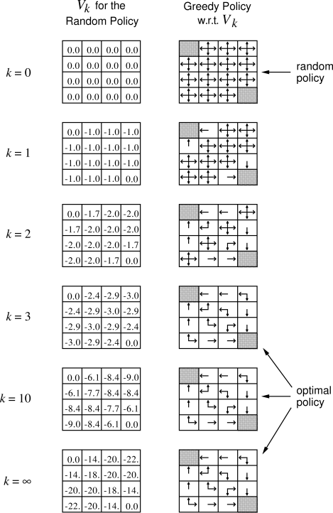
Policy Improvement: Examples
(Actions Deterministic,
Goal state(s) shaded)

Slide 12
Policy Improvement: Examples
4.1: If policy is equiprobably random actions, what is the action-value for Q(11,down)? What about Q(7, down)?
4.2a: A state (15) is added just below state 13. Its actions, left, up, right, and down, take the agent to states 12, 13, 14, and 15, respectively. Transitions from original states are unchanged. What is V(15) for equiprobable random policy?
4.2b: Now, assume dynamics of state 13 are also changed so that down takes the agent to 15. Now, what is V(15)?

Slide 13
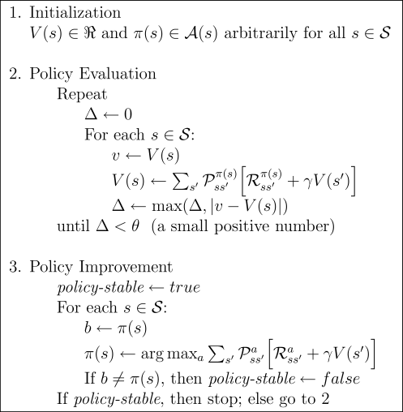
Policy Iteration
Convergence in limit
vs. EM? (Dmitry & Chris)

Slide 14
Value Iteration: Update
Turn Bellman optimality equation
into an update rule

Slide 15
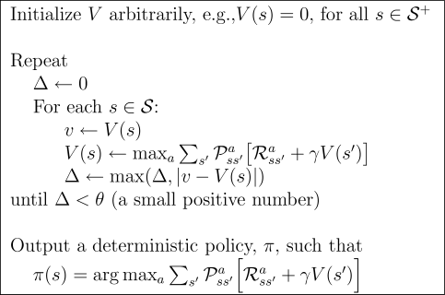
Value Iteration: algorithm
Why focus on deterministic policies?

Slide 20
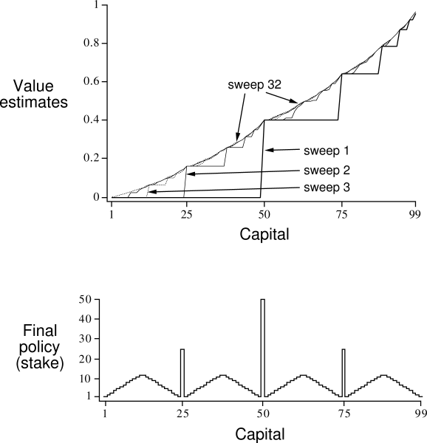
Gambler’s problem
Series of coin flips. Heads: win as many dollars as staked. Tails: lose it.
On each flip, decide proportion of capital to stake, in integers
Ends on $0 or $100
Example: prob of heads = 0.4

Slide 21
Gambler’s problem
Series of coin flips. Heads: win as many dollars as staked. Tails: lose it.
On each flip, decide proportion of capital to stake, in integers
Ends on $0 or $100
Example: prob of heads = 0.4

Slide 22
Asynchronous DP
Can backup states in any order
But must continue to back up all values, eventually
Where should we focus our attention?

Slide 23
Asynchronous DP
Can backup states in any order
But must continue to back up all values, eventually
Where should we focus our attention?
Changes to V
Changes to Q
Changes to π

Slide 24
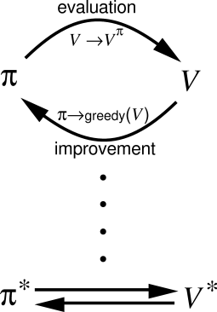
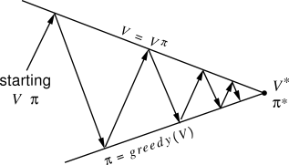
Generalized Policy Iteration

Slide 25
Generalized Policy Iteration
V stabilizes when consistent with π
π stabilizes when greedy with respect to V

