Slide 1
Sutton & Barto, Chapter 4
Dynamic Programming

Slide 3
Policy Improvement Theorem
Let π & π’ be any pair of deterministic policies s.t. for all s in S,
Then, π’ must be as good as, or better than, π:
If 1st inequality is strict for any state, then 2nd inequality must be strict for at least one state

Slide 4
Policy Iteration
Value Iteration

Slide 5
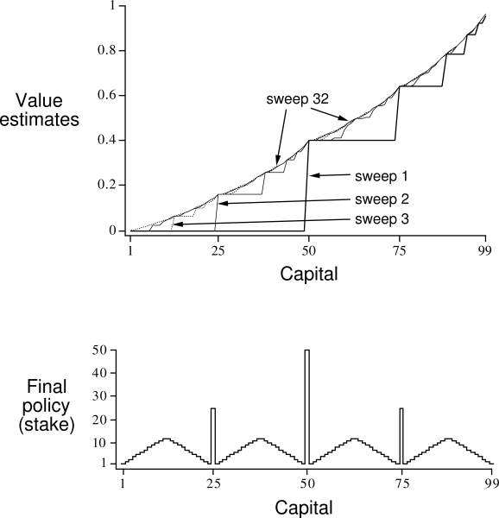
Gambler’s problem
Series of coin flips. Heads: win as many dollars as staked. Tails: lose it.
On each flip, decide proportion of capital to stake, in integers
Ends on $0 or $100
Example: prob of heads = 0.4

Slide 6
Gambler’s problem
Series of coin flips. Heads: win as many dollars as staked. Tails: lose it.
On each flip, decide proportion of capital to stake, in integers
Ends on $0 or $100
Example: prob of heads = 0.4

Slide 7
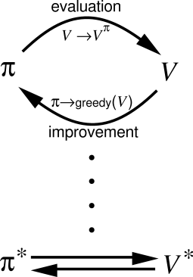
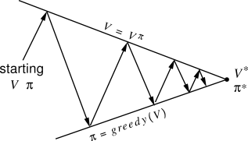
Generalized Policy Iteration

Slide 8
Generalized Policy Iteration
V stabilizes when consistent with π
π stabilizes when greedy with respect to V

Slide 10
Asynchronous DP
Can backup states in any order
But must continue to back up all values, eventually
Where should we focus our attention?

Slide 11
Asynchronous DP
Can backup states in any order
But must continue to back up all values, eventually
Where should we focus our attention?
Changes to V
Changes to Q
Changes to π

Slide 12
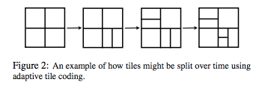
Aside
Variable discretization
When to Split
Track Bellman Error: look for plateaus
Where to Split
Which direction?
Value Criterion: Maximize the difference in values of subtiles = minimize error in V
Policy Criterion: Would the split change policy?

Slide 13
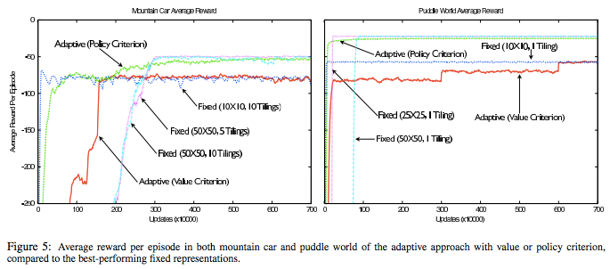

Slide 14
Optimal value function satisfies the fixed-point equation for all states x:
Define Bellman optimality operator:
Now, V* can be defined compactly:

Slide 15
T* is a maximum-norm contraction.
The fixed-point equation, T*V=V, has a unique solution
Or, let T* map Reals in X×A to the same, and:

Slide 16
Value iteration:
V_{k+1}=T*V_{k}, k≥0
Q_{k+1}=T*Q_{k}, k≥0
This “Q-iteration” converges asymptotically:
(uniform norm/supremum norm/Chebyshev norm)

Slide 17
Also, for Q-iteration, we can bound the suboptimality for a set number of iterations based on the discount factor and maximum possible reward

Slide 18
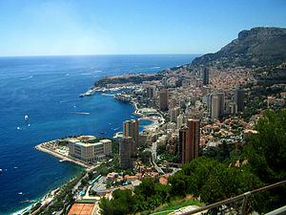
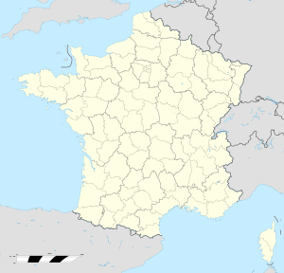
Monte Carlo
Administrative area in the Principality of Monaco
Founded in 1866, named “Mount Charles” after then-reigning price, Charles III of Monaco
1st casino opened in 1862, not a success

Slide 19
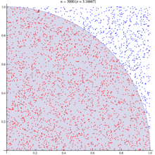
Monte Carlo Methods
Computational Algorithms: repeated random sampling
Useful when difficult / impossible to obtain a closed-form expression, or if deterministic algorithms won’t cut it
Modern version: 1940s for nuclear weapons program at Los Alamos (radiation shielding and neutron penetration)
Monte Carlo = code name (mathematician’s uncle gambled there)
Soon after, John von Neumann programmed ENIAC to carry out these calculations
Physical Sciences
Engineering
Applied Statistics
Computer Graphics, AI
Finance/Business
Etc.

Slide 20
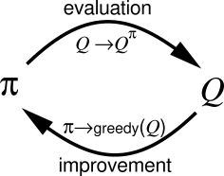
Rollouts
Exploration vs. Exploitation
On- vs. Off-policy

