Slide 1
Collaborative Driving and Congestion Management
Chris Cain

Slide 2
Introduction
Current traffic control assumes human behind wheel
Future goal is vehicle control without direct human involvement
Intelligent vehicles
Autonomous vehicle control/safety
Collaborative control systems

Slide 3
Outline
Learning Agents for Collaborative Driving
How can reinforcement learning be used to communicate between vehicles and automate vehicle functions?
Traffic Congestion Management as a Learning Agent Coordination Problem
Which reward structures best learn departure times and lane selection?

Slide 4
Current Technology
Adaptive Cruise Control
Detect upcoming vehicle, adjust cruise speed to avoid collision
Automated parking
Lane-keeping assistance
Detect curvature of road, make small steering adjustments
Collision detection and avoidance
Most driving still left to driver

Slide 5
Roadblocks
Communication
Vehicle-to-Vehicle
Road-to-vehicle
Possible solution: DSRC = Direct Short-Range Communication
one-way or two-way short-range to medium-range wireless communication channels specifically designed for automotive use
Currently being developed

Slide 6
Previous Work
Lane change advisory (Pendrith, 2000): Used distributed variant of Q-Learning to collect relative velocities of surrounding vehicles. Saw increase in traffic stability, issue was lack of learning stability
Traffic management (Moriarty and Langley, 1998): Vehicles select lane which optimizes traffic flow performance. Reinforcement learning and neuro-evolution methods keep set of strategies. Result: Optimize velocities, reduce number of lane changes

Slide 7
Agent Abstraction
Rosenblatt (1995) proposed framework based on centralized arbitration of votes from many independent and asynchronous processes.
object avoidance
Hallé & Chaib-draa (2005) use 3-level architecture (guidance, management, traffic) to assign roles to vehicles in platoons (leader, follower, splitter).

Slide 8
Review of MDPs
Requires sequential task: decisions are made at fixed intervals of time
Markov property: current state contains all information agent needs to make decision. Needed for MDP to be solvable
Resolution of MDP yields a policy via value iteration or Q-learning
Downside: Dimensionality too high. Solution: Policy-gradient algorithms

Slide 9
Multiple Agents
Each agent only observes a part of the system state. Each joint observation makes up a system state.
Optimal solution maximizes some combination of individual rewards
Need to have model of environment to solve optimally
Individual states, actions and rewards need to be communicated between agents to learn good policies

Slide 10
Extensions of ACC
Cooperative ACC (acceleration of upcoming vehicle shared, used to reduce distance between vehicles, out of range of standard sensors, helps make better driving decisions, increases efficiency and safety)
Coordination layer: selects high level driving actions. Uses info from other communicating vehicles to select an action that maximizes local and global safety/traffic efficiency
Action layer: selects actions directly related to vehicle actuators. This action is communicated to coordination layer, which broadcasts to neighboring cars
Neighboring cars can take a responsive action to this action before coordination layer makes another decision.
Discussion: Which RL algorithms would work best for each layer? Why?

Slide 11
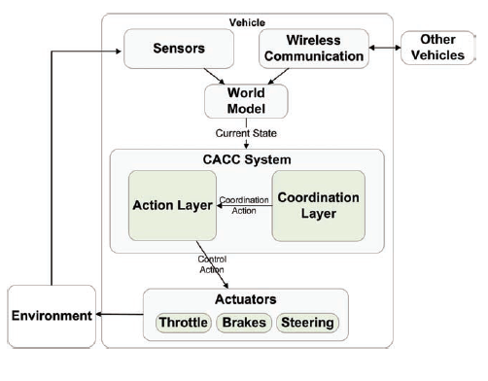
CACC

Slide 12
More on Action Layer
Negative rewards given if vehicle is too close or too far from nearest car ahead of it
Positive values given if vehicle is within desired range or too far away and closing the gap
Behavior learned does not depend on velocity, and generalizes to any driving scenario
Lane change policy designed manually

Slide 13
Partial Friend Q-Learning
Based on Friend Q-Learning, a multi-agent variant of Q-Learning
Apply Friend Q-Learning on partial views and partial joint actions rather than fully observable states and joint actions
Agent chooses action contained in joint action which maximizes Q-value in the current state. Then it observes partial states and partial joint actions and rewards, and updates Q
Computes policy for each agent for a fixed distance such that cars farther away don't influence the decision-making process

Slide 14
Experiment
Stop & Go simulation done using microscopic traffic simulator, which accurately models vehicles, and includes forward sensors and communication devices
Leading vehicle accelerates to 20m/s, brakes to 7m/s, accelerates back up to 20m/s. Goal = secure 2 seconds behind leading vehicle
Control policy learned with OLPOMDP policy-gradient algorithm (generates policy which returns probabilities of selecting actions from given state)
10 learning simulations of 5,000 episodes each due to stochastic gradient descent

Slide 15
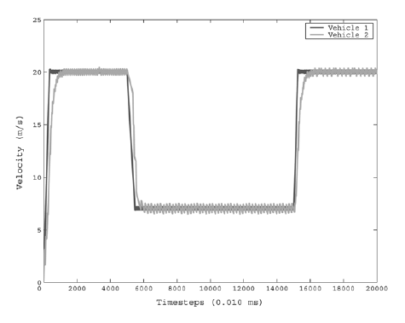
Experiment
By the end of learning episodes, vehicle in safe region 475 out of 500 time steps
Seems like following car is constantly accelerating and decelerating. Would waste gas and potentially make ride uncomfortable for human passengers

Slide 16
Limitations
Does not account for sensor noise
Would need to have provable perfect safety before it could be put on market

Slide 17
Traffic Congestion as a Learning Agent Coordination Problem
Two Problems
Selecting departure time to minimize trafic delay
Selecting lane to minimize congestion
Agents need to receive rewards which align with system reward and are sensitive to actions of agents

Slide 18
Factoredness vs. Learnability
Factoredness: How aligned local rewards are to global rewards
Learnability: Extent to which agent's rewards are sensitive to own changes, insensitive to changes of others
Drivers need to be able to see effects of individual actions on their overall reward. Extreme case, driver just given a "good" or "bad" score at end of day

Slide 19
Methodology for Selecting Departure Times
Used epsilon-greedy, no discount method
Simulation: Times have desirabilities
Each agent selects time to depart independently
Non-cascading: Drivers enter and exit a same time slot
Cascading: Drivers stuck in congested traffic remain on road for additional time periods
Objective: maximize throughput
Performance measure: System-wide utility. Sum of all agent rewards.
Desirability of selected slot
Time slot reward based on how many other drivers selected that slot

Slide 20
Reward Types
Global: Agent receives same reward as system
Local: Agent receives reward based on time selected and number of other agents who selected that time
Difference: Agent receives reward equal to difference between system reward and how system would have performed with agent removed

Slide 21
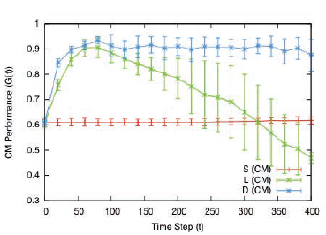
Non-Cascading Single Peak
500 cars, optimal capacity at any time slot is 125
Weight vector of time preferences [1,5,10,15,20,15,10,5,1]
Each day, agent makes decision based off information from past days

Slide 22
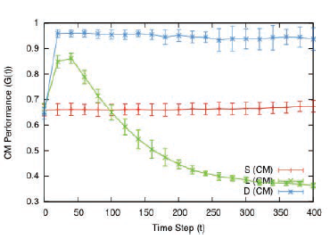
Non-Cascading Double Peak
Weight vector of time preferences [1,10,20,10,1,10,20,10,1]

Slide 23
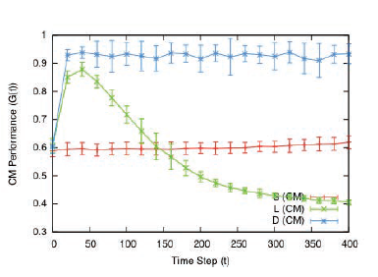
Non-Cascading Non-Symmetric
Weight vector of time preferences [1,1,2,3,5,8,13,21,34]

Slide 24
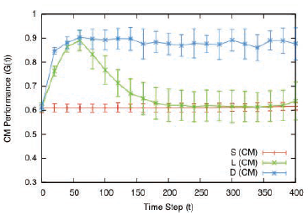
Cascading Single Peak
Drivers stay on road until time slot is at less than capacity
Difference method takes into account how many drivers would have been on road at certain time slot without this agent

Slide 25
Lane Selection
Drivers choose lanes which have different capacities and desirabilities
Number of cars in lane irrelevant, as long as below capacity
System reward: Sum of lane rewards, weighted by lane value
Capacity [167,83,33,17,9,17,33,83,167]
Desirability [1,5,10,1,5,10,1,5,10]

Slide 26
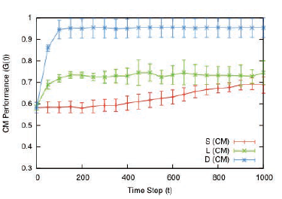
Results

Slide 27
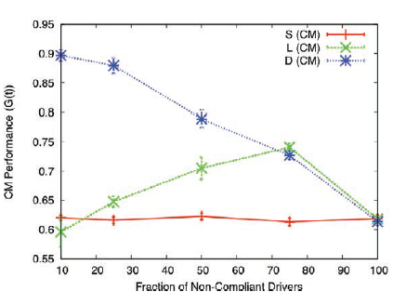
Non-Compliant Drivers
Some drivers don't conform to model and take random actions

Slide 28
Discussion
How to get people to value difference learning?
How to ensure drivers follow advice of agents?
Prisoner's dilemma

Slide 29
Thank you!

