Slide 1
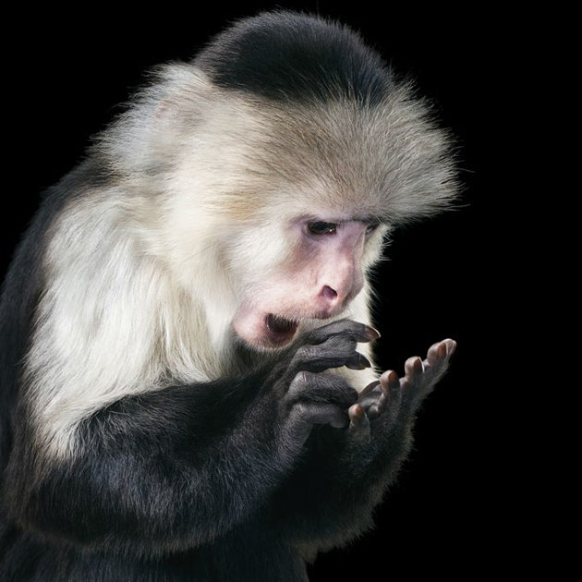
Retraction: I’m actually 35 years old

Slide 3
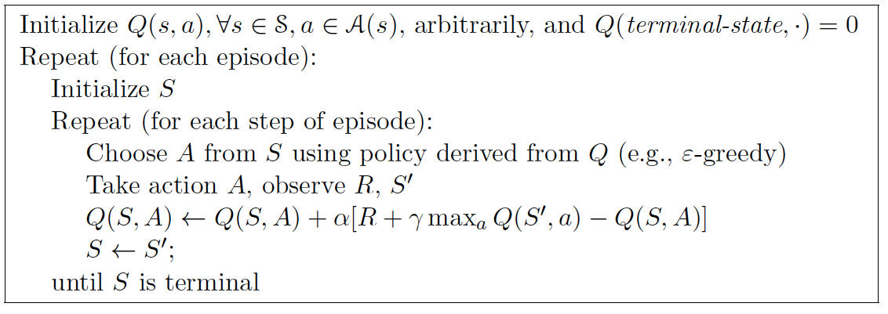
Q-Learning

Slide 4
Decaying learning rate?
Decaying exploration rate?

Slide 5
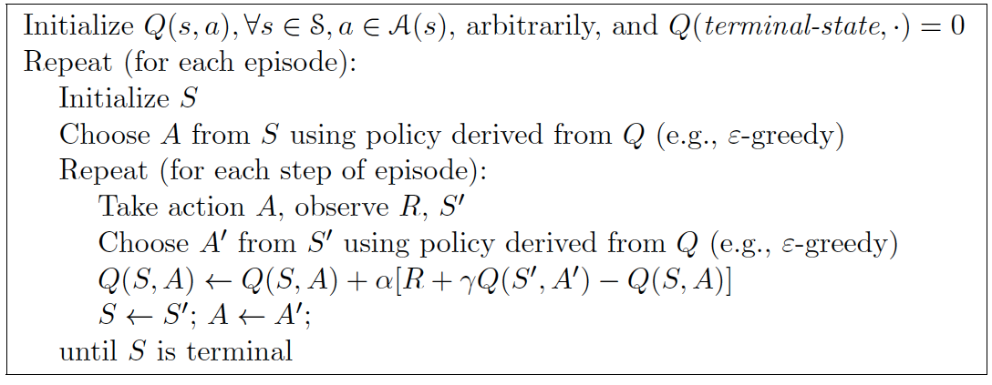
Sarsa

Slide 6
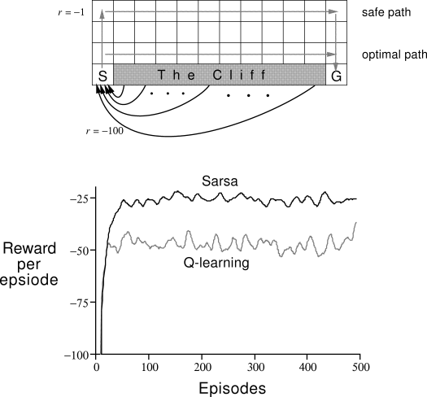
On- vs. Off-Policy Learning

Slide 7
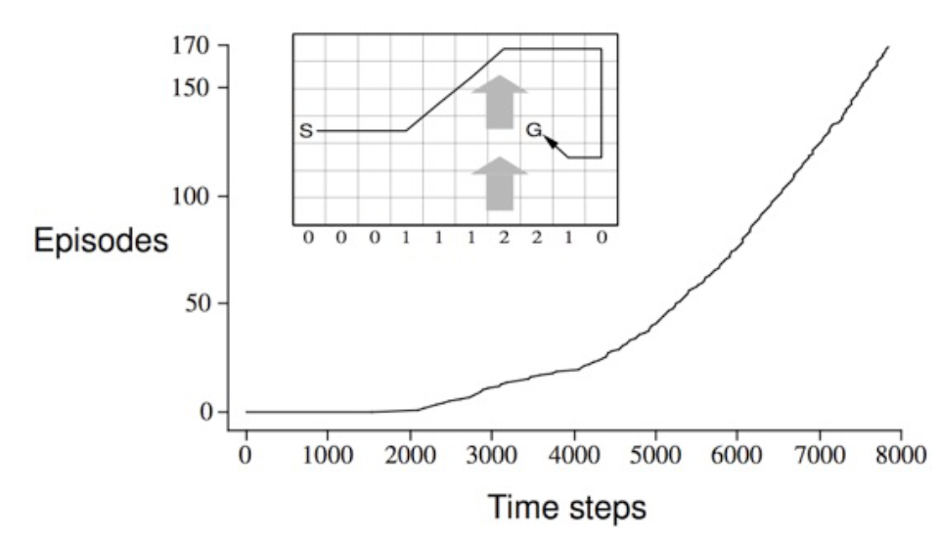
Why could this be a challenge for MC?
How could you solve this task with MC?

Slide 8
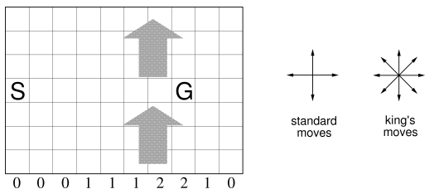
Ex 6.6: Resolve the windy gridworld task assuming eight possible actions, including the diagonal moves, rather than the usual four. How much better can you do with the extra actions? Can you do even better by including a ninth action that causes no movement at all other than that caused by the wind?

Slide 9
TD(0), prediction
Sarsa, On-policy learning
Q-Learning, Off-policy learning
Sarsa & Q-learning have no explicit policy

Slide 10
Policy, Q(up), Q(down), Q(left), Q(right)
Deterministic transitions
α = 0.1, γ = 1.0, step r = -0.1
U 0,0,0,0 | R 0,0,0,0 | R 0,0,0,0 | +1
U 0,0,0,0 |  | U 0,0,0,0 | -1
U 0,0,0,0 | R 0,0,0,0 | R 0,0,0,0 | U 0,0,0,0

Slide 11
Modified update
On- or Off-policy?
How do you think it’d do on the cliff world?

Slide 12
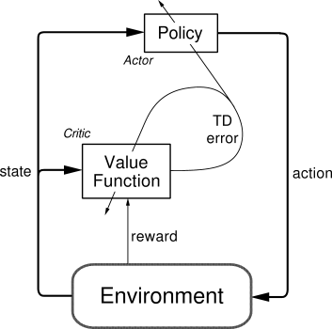
Actor-Critic
On-policy learning
Critic: Value function
If result is better than I thought it’d be, take that action more often
Actor: Explicit policy
Policy evaluation / improvement
Sound familiar?

Slide 13
Actor-Critic

Slide 14
Actor-Critic

Slide 15
Actor-Critic
Minimal computation to select actions
Can learn explicit stochastic policies

Slide 16
Policy Improvement
R.S. Sutton, D. McAllester, S. Singh, and Y. Mansour. Policy gradient methods for reinforcement learning with function approximation. NIPS, 2000
Policy gradient improvement
θ is vector of policy parameters
ρ is the policy performance (e.g., average reward per step)
α is learning rate
Can (usually) be assured to converge
Small changes to θ can cause only small changes to policy / state-visitation distribution
Approximate gradient via experience
Also: V. Konda and J. Tsitsiklis. Actor-critic algorithms. In NIPS, 2000

Slide 17
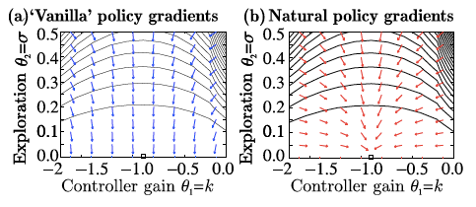
Natural Actor-Critic: Peters and Schaal, 2008
Vanilla policy gradient follow gradient of the expected return function J(θ)
Often gets stuck in plateaus

Slide 18
Natural Actor-Critic: Peters and Schaal, 2008
Natural gradients avoid this problem
Does not follow steepest direction in parameters space, but steepest direction w.r.t. Fisher metric:
G(θ) is Fisher information matrix
amount of information that an observed random variable X carries about an unknown parameter θ, upon which P(X) depends
Depends on choice of coordinate system
Convergence to next local optimum is assured

Slide 19
Actor-critic advantage
Combine different methods for policy improvement with methods for policy evaluation
E.g., Least-Squares Temporal Difference (LSTD)

Slide 20
Ergodic process: nonzero probability of reaching any state from any other under any policy

Slide 21
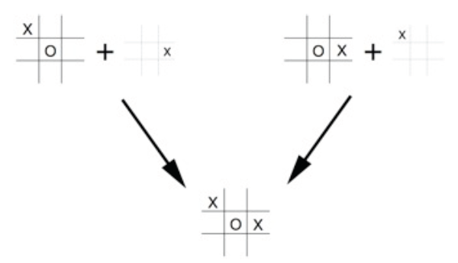
Afterstates
Where else would these be useful?

Slide 22
Quiz!
If a policy is greedy w.r.t. the value function for the equiprobable random policy, then it is an optimal policy. Why or why not?
If a policy π is greedy w.r.t. its own value function, V^{π}, then it is an optimal policy. Why or why not?
When would you use TD(0), Sarsa, or Q-Learning (vs. the other 2 algorithms listed)

Slide 23
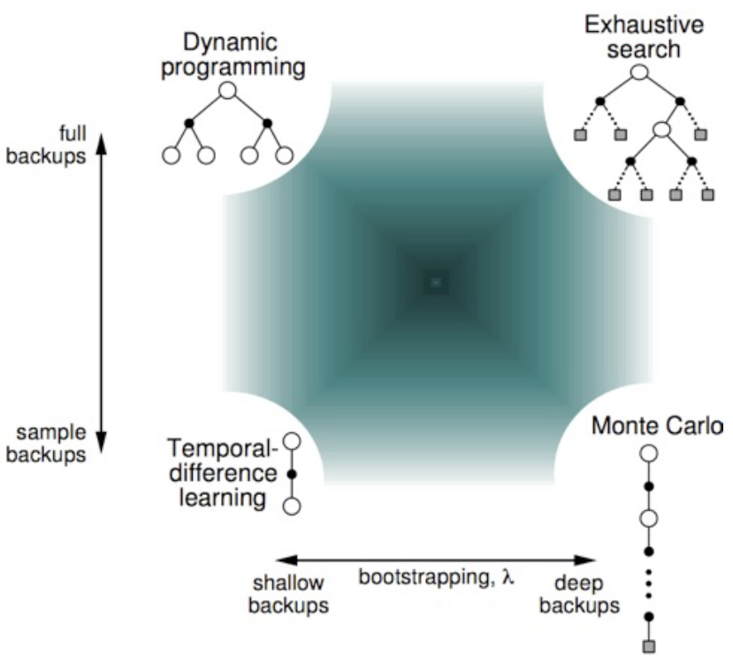
Unified View

