Slide 1
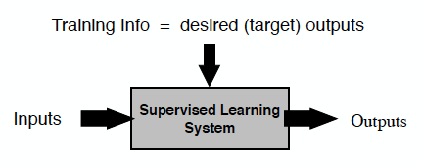
Insight: Steal from Existing Supervised Learning Methods!
Training = {X,Y}
Error = target output – actual output

Slide 2
TD Backups as Training Examples
Recall the TD(0) backup:
As a training example:
Input = Features of s_{t}
Target output = r_{t+1} + γV(s_{t+1})

Slide 3
What FA methods can we use?
In principle, anything!
Neural networks
Decision trees
Multivariate regression
Support Vector Machines
Gaussian Processes
Etc.
But, we normally want to
Learn while interacting
Handle nonstationarity
Not take “too long” or use “too much” memory
Etc.

Slide 4
Perceptron
Binary, linear classifier: Rosenblatt, 1957
Eventual failure of perceptron to do “everything” shifted field of AI towards symbolic representations
Sum = w₁x₁ + w₂x₂ + … + w_{n}x_{n}
Output is +1 if sum > 0, -1 otherwise
w_{j} = w_{j} + (target – output) x_{j}
Also, can use x₀ = 1 and w₀ is therefore a bias

Slide 5
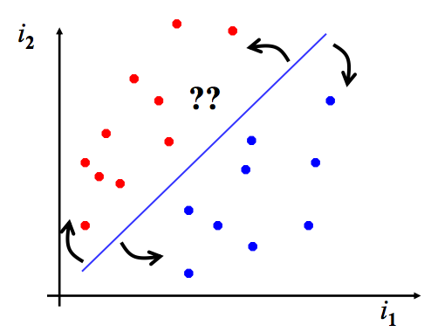
Perceptron
Consider Perceptron with 3 weights:
x, y, bias

Slide 6
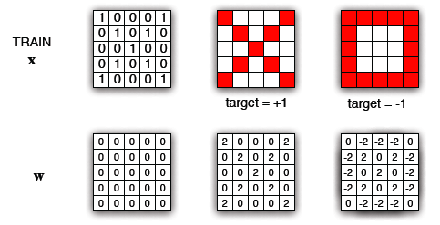
Spatial-based Perceptron Weights

Slide 8
Gradient Descent
w = (w₁, w₂, …, w_{n})^{T}
Assume V_{t}(s) sufficiently smooth differential function of w, for all states s in S
Also, assume that training examples are in the form:
Features of s_{t} ➔V^{π}(s_{t})
Goal: minimize errors on the observed samples

Slide 9
w_{t+1}=w_{t} + α[V^{π}(s_{t})-V_{t}(s_{t})] _{wt}V_{t}(s_{t})
Vector of partial derivatives
Recall… what is
1D: derivative
Field (function defined on multi-dimensional domain): gradient of scalar field, gradient of vector field, divergence of vector field, or curl of vector field
Δ
Δ

Slide 10
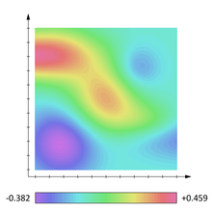
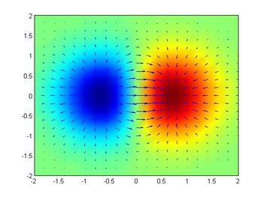
Scalar field
Gradient

Slide 11
Let J(w) be any function of the weight space
The gradient at any point w_{t} in this space is:
Then, to iteratively move down the gradient:
Why still doing this iteratively? If you could just eliminate the error, why could this be a bad idea?

Slide 12
Common goal is to minimize mean-squared error (MSE) over distribution d:
Why does this make any sense?
d is distribution of states receiving backups
on- or off-policy distribution

Slide 13
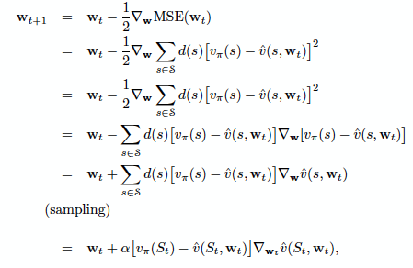
Gradient Descent
Each sample gradient is an unbiased estimate of the true gradient
This will converge to a local minimum of the MSE if α decreases “appropriately” over time

Slide 14
Unfortunately, we don’t actually have v_{π}(s)
Instead, we just have an estimate of the target V_{t}
If the V_{t} is an an unbiased estimate of v_{π}(s_{t}), then we’ll converge to a local minimum (again with α caveat)

Slide 15
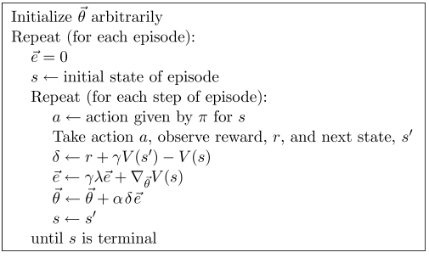
δ is or normal TD error
e is vector of eligibility traces
θ is a weight vector

Slide 16
Discussion: Pac-Man
http://eecs.wsu.edu/~taylorm/15_580/Pacman_SarsaPacMan.java
http://eecs.wsu.edu/~taylorm/15_580/Pacman_QFunction.java

Slide 17
Note that TD(λ) targets are biased
But… we do it anyway

Slide 18
Linear Methods
Why are these a particularly important type of function approximation?
Parameter vector θ_{t}
Column vector of features φ_{s} for every state
(same number of components)

Slide 19
Linear Methods
Gradient is simple
Error surface for MSE is simple (single minimum)

Slide 21
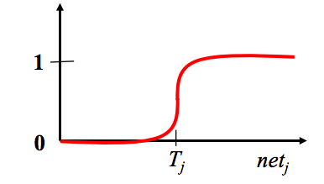
Neural Networks
How do we get around only linear solutions?

Slide 22
Neural Networks
A multi-layer network of linear perceptrons is still linear.
Non-linear (differentiable) units
Logistic or tanh function

