Slide 1
http://www.xconomy.com/seattle/2015/03/12/theres-an-algorithm-for-that-algorithmia-helps-you-find-it/

Slide 2
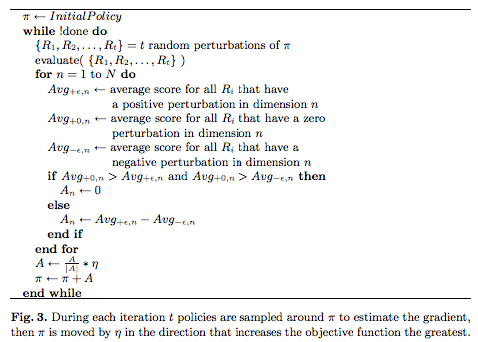
Autonomous Learning of Stable Quadruped Locomotion, 2007
Policy gradient algorithm

Slide 3
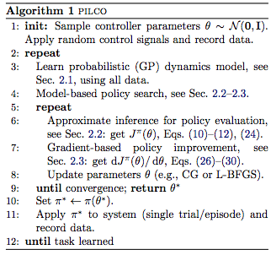
PILCO: Deisenroth & Rasmussen, 2011
Model-based policy search method

Slide 4
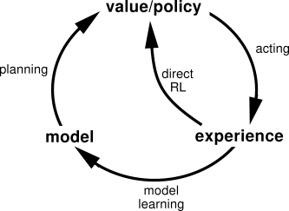
Learning: Uses experience
Planning: Use simulated experience

Slide 5
Models
How would we learn to estimate them?
Discrete state space
Continuous state space

Slide 6
Planning
State space planning: search of state space
Plan-space planning: search of plans
Genetic Algorithms
Partial-order planning
Dynamic programming: have a model
Model-based RL (aka Model-learning RL) : learn a model

Slide 7
Random-sample on-step tabular Q-planning

Slide 8
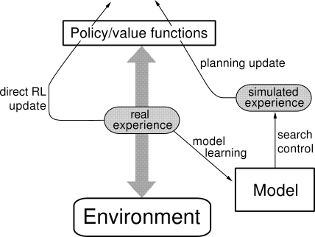
Dyna
Search Control
Direct simulated experience
Planning, acting, model learning, direct RL in parallel!

Slide 9
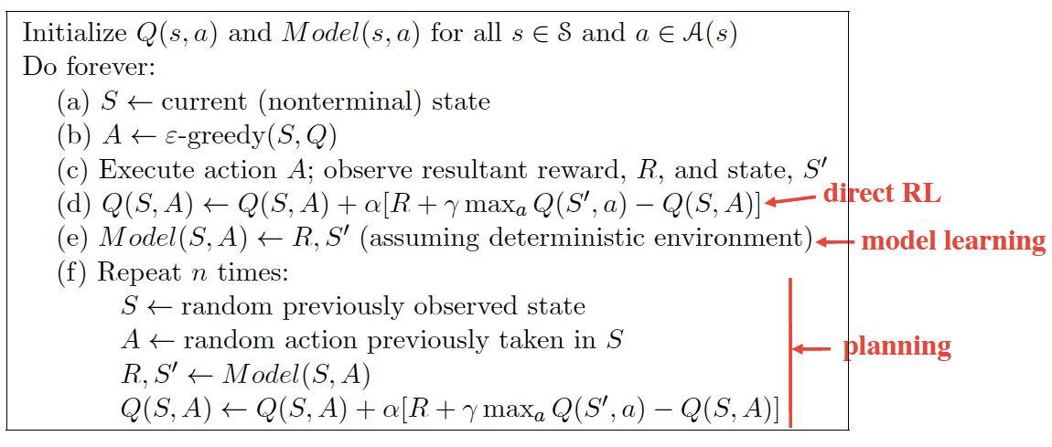
Dyna-Q

Slide 10
Collect Data
Generate Model
Plan over model
…
Profit!

Slide 11
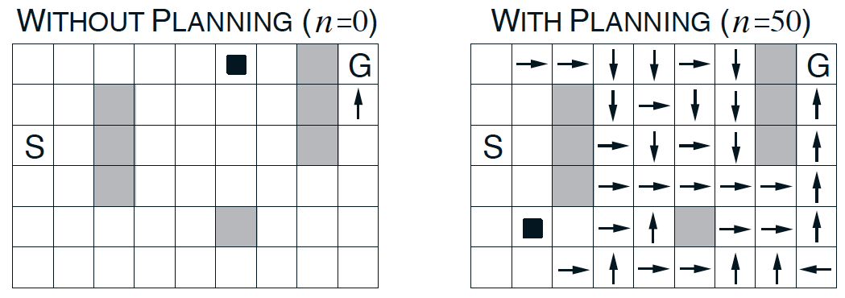
Without planning: each episode adds only one additional step to the policy, and only one step (the last) has been learned so far
With planning: only one step is learned during the first episode, but here during the second episode an extensive policy has been developed that by the episode's end will reach almost back to the start state.

Slide 12
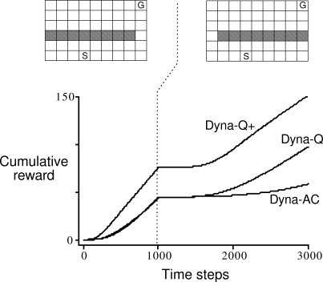
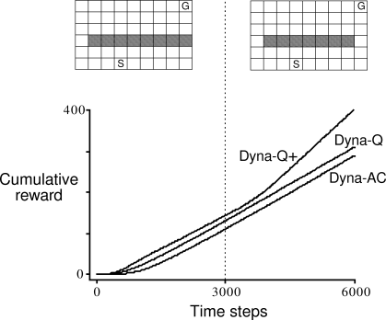
Dyna-Q+ is Dyna-Q with exploration bonus (shaping reward) :
why the square root of time steps was chosen, rather than, say, changing linearly.
Notes:
Dyna-Q+: r + \kappa \sqrt n (can encourage planning to get over to untried states)

Slide 13
Dyna-Q+ is Dyna-Q with exploration bonus
Why is Dyna-Q+ much better on left, but only slightly better on right?
Notes:
Dyna-Q+: r + \kappa \sqrt n (can encourage planning to get over to untried states)

Slide 14
Dyna-Q+ is Dyna-Q with exploration bonus
Why is Dyna-Q+ much better on left, but only slightly better on right?
Model is “optimistic”
Think pessimistic vs. optimistic initialization
Notes:
Dyna-Q+: r + \kappa \sqrt n (can encourage planning to get over to untried states)

Slide 15
Prioritized Sweeping
Priority Queue over s,a pairs whose estimated value would change non-trivially
When processed, effect on predecessor pairs is computed and added
Other ideas:
Change in policy?
Continuous state space: http://www.eecs.berkeley.edu/Pubs/TechRpts/2000/CSD-00-1109.pdf
“All animals are equal, but some are more equal than others.”
George Orwell, Animal Farm

Slide 16
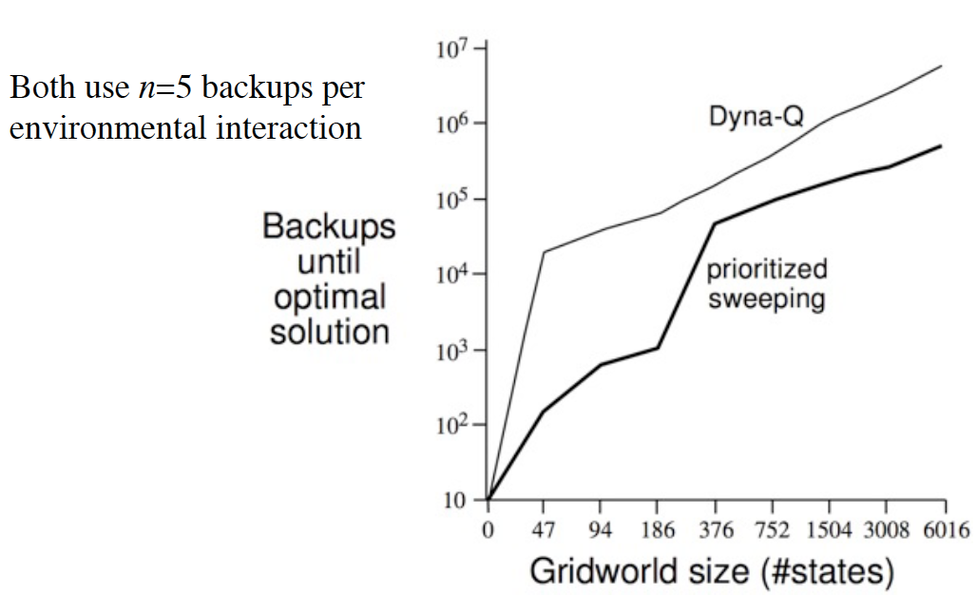
Prioritized Sweeping vs. Dyna-Q

Slide 17
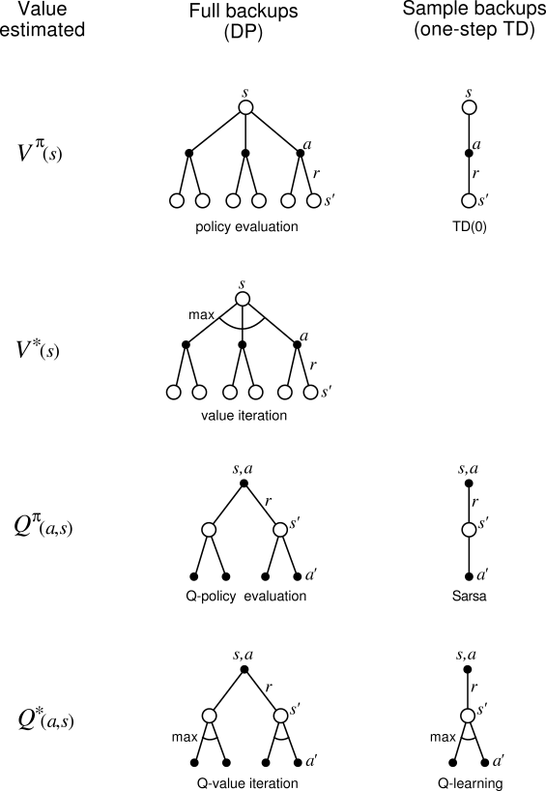

Slide 18
Trajectory sampling: perform backups along simulated trajectories
Samples from on-policy distribution
May be able to (usefully) ignore large parts of state space

Slide 19
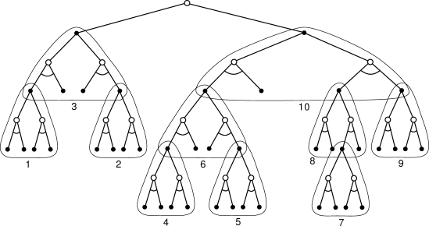
How to backup
Full vs. Sample
Deep vs. Shallow
Heuristic Search

Slide 20
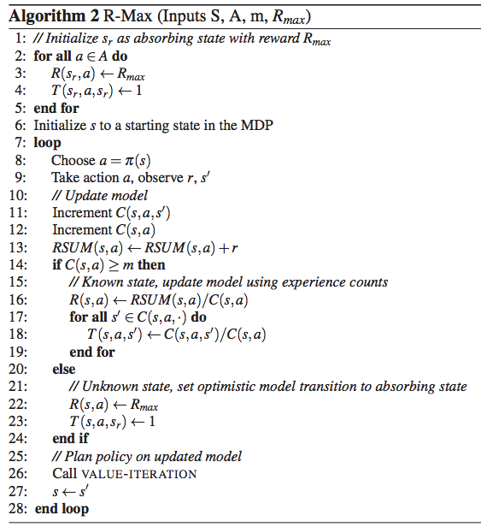
R-Max

Slide 21
R-Max (1/2)
Stochastic games
Matrix: strategic form
Sequence of games from some set of games
More general than MDPs (how map to MDP?)
Implicit Exploration vs. Explicit Exploration?
Epsilon greedy, UCB1, optimistic value function initialization
What will a pessimistic initialization do?
Assumptions: recognize the state it’s in, and knows the actions/payoffs received
Maximin

Slide 22
R-Max (2/2)
Either optimal, or efficient learning
Mixing time
Smallest value of T after which π guarantees expected payoff of U(π) – ε
Approach optimal policy, in time polynomial in T, in 1/ε, and ln(1/δ)
PAC

Slide 23
Efﬁcient Reinforcement Learning with Relocatable Action Models
http://bit.ly/1mJ3KDU
RAM
Grid-World Experiment
Algorithm

