Slide 1
Exercise 4
Soon…
Grades for 1-3: Soon… ?
Class presentation: Next Tuesday to final Tuesday (28th of this month)

Slide 2
Survey: S14
What were the best things about Matt making you lead one class discussion?
Good for presentation skills: 4
Good for presenter to learn a topic in depth: 5
Nice to see a selection of different topics: 1

Slide 3
Survey: S14
What were the worst things?
Some presenters were not prepared enough: 2
Some topics were too advanced/technical for the point in the class or were hard to follow: 4

Slide 4
Survey: S14
Do you think Matt should do this next year?
Yes: 7
Maybe: 1
Sure, why not?: 1
No: 0

Slide 5
Survey: S14
If Matt does it next year, how could he change it?
Require handout with takeaways and resources: 1
Require more discussion / engagement: 3
Better scheduling: avoid jumping around, avoid duplication (or group together): 2
Be clear about using examples from exercises: 1
Give a short presentation to Matt a week before. This will improve presentations and get more suggested readings: 1

Slide 6
Final Project Rubric
Initial proposal (due next Wednesday, 1-3 paragraphs on Piazza)
Draft due on final day of class
Final draft

Slide 7
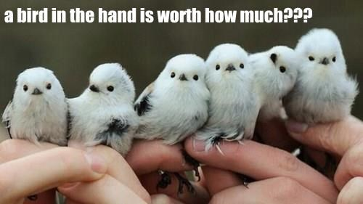
Final Project Rubric
Initial proposal (due next Wednesday, 1-3 paragraphs on Piazza)
Draft due on final day of class
Final draft
20: Fully explained idea or question addressed (Why is it interesting? What’s the payoff if it works?)
20: Experiments and/or theoretical work adequately addresses idea/question
20: Background & Related Work (Is it clear how this work is related to other things in the field? Is it clear what is/isn’t novel?)
15: Conclusion and discussion of future work (What are the next steps for you, or others, who are interested in this?)
10: Writing quality (scaled)
10: Presentation quality (Does this look like something you’d submit to a conference?)

Slide 8
"Intrinsic motivation occurs when we act without any obvious external rewards. We simply enjoy an activity or see it as an opportunity to explore, learn, and actualize our potentials."
(Coon & Mitterer, 2010)
"Intrinsic motivation refers to the reason why we perform certain activities for inherent satisfaction or pleasure; you might say performing one of these activities in reinforcing in-and-of itself."
(Brown, 2007)

Slide 9
Intrinsically Motivated Reinforcement Learning. Singh, Barto, and Chentanez
Slides modified from:
A. Barto, Hierarchical Organization of Behavior, NIPS 2007 Workshop

Slide 10
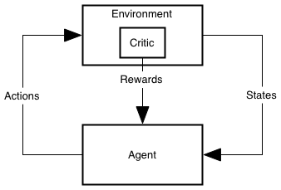
The Usual View of RL
PrimaryCritic

Slide 11
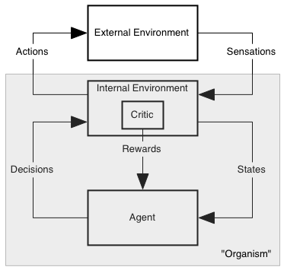
The Less Misleading View
PrimaryCritic

Slide 12
Motivation
“Forces” energize an organism to act and direct its activity
Extrinsic Motivation: being moved to do something because of some external reward ($$, a prize, etc.)
Intrinsic Motivation: being moved to do something because it is inherently enjoyable
Curiosity, Exploration, Manipulation, Play, Learning itself . . .
Examples of intrinsic motivation?
How/Why useful?

Slide 13
Robert White’s famous 1959 paper
“Motivation Reconsidered: The Concept of Competence”
Psychological Review, Vol. 66, pp. 297–333, 1959
Critique of Hullian and Freudian drive theories that all behavior is motivated by biologically primal needs (food, drink, sex, escape, …)
Either directly or through secondary reinforcement
Competence: an organism’s capacity to interact effectively with its environment
Cumulative learning: significantly devoted to developing competence

Slide 14
What is Intrinsically Rewarding?
novelty
surprise
salience
incongruity
manipulation
“being a cause”
mastery: being in control
curiosity
exploration
…
See D. E. Berlyne’s writings for more data and suggestions

Slide 15
An Example of Intrinsically Motivated RL
Rich Sutton, “Integrated Architectures for Learning, Planning and Reacting based on Dynamic Programming” In Machine Learning: Proceedings of the Seventh International Workshop, 1990.
For each state and action, add a value to the usual immediate reward called the exploration bonus
… a function of the time since that action was last executed in that state. The longer the time, the greater the assumed uncertainty, the greater the bonus
Recall: Dyna-Q+
Facilitates learning of environment model

Slide 16
What are features of IR?
IR depends only on internal state components
These components track aspects of agent’s history
IR can depend on current Q, V, π, etc.
IR is task independent (where task is defined by extrinsic reward)
IR is transient: e.g. based on prediction error
…
Most have goal of efficiently building “world model”

Slide 17
Where do Options come from?
SMDP
Many can be hand-crafted from the start (and should be!)
How can an agent create useful options for itself?
Notes:
This is a difficult task:
unknown how humans create abstractions
temporal and structural credit assignment problem
hard for humans to introspect to the robot’s sensory set
As an example, consider a robot on the moon or mars that needs to perform some task, such as building a human habitat, in an efficient manner. The robot is not able to be fully pre-programmed because of the differences between the environments and it is not able to be fully tele-operated due to the time lag between Earth and Mars. If it can autonomously create abstractions to categorize its interactions with its environment, it will be better able to learn and plan and react to new situations. This greater autonomy will mean a more robust robot.
Don’t say “whatever”

Slide 18
Lots of Approaches
visit frequency and reward gradient [Digney 1998],
visit frequency on successful trajectories [McGovern & Barto 2001]
variable change frequency [Hengst 2002]
relative novelty [Simsek &Barto 2004]
salience [Singh et al. 2004]
clustering algorithms and value gradients [Mannor et al. 2004]
local graph partitioning [Simsek et al. 2005]
causal decomposition [Jonsson & Barto 2005]
exploit commonalities in collections of policies [Thrun & Schwartz 1995, Bernstein 1999, Perkins & Precup 1999, Pickett & Barto 2002]
Many of these involve identifying subgoals

Slide 19
Creating Task-Independent Subgoals
Our approach: learn a collection of reusable skills
Subgoals = intrinsically rewarding events

Slide 20
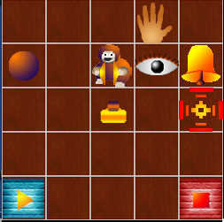
A not-quite-so-simple example: Playroom
Singh, Barto, & Chentanez 2005
Agent has eye, hand, visual marker
Actions:
move eye to hand
move eye to marker
move eye to random object
move hand to eye
move hand to marker
move marker to eye
move marker to hand
If both eye and hand are on object: turn on light, push ball, etc.

Slide 21
Playroom cont.
Switch controls room lights
Bell rings and moves one square if ball hits it
Press blue/red block turns music on/off
Lights have to be on to see colors
Can push blocks
Monkey laughs if bell and music both sound in dark room

Slide 22
Skills
To make monkey laugh:
Move eye to switch
Move hand to eye
Turn lights on
Move eye to blue block
Move hand to eye
Turn music on
Move eye to switch
Move hand to eye
Turn light off
Move eye to bell
Move marker to eye
Move eye to ball
Move hand to ball
Kick ball to make bell ring
Using skills (options)
Turn lights on
Turn music on
Turn lights off
Ring bell

Slide 23
Option Creation and Intrinsic Reward
Subgoals: events that are “intrinsically interesting.” Here, unexpected changes in lights and sounds
On first occurrence, create an option with that event as subgoal
Intrinsic reward generated whenever subgoal is achieved:
Proportional to the error in prediction of that event (“surprise”)… decreases with experience
Use a standard RL algorithm with R=IR+ER
Previously learned options are available as actions for learning policies of new options (primitive actions always available too)

Slide 24
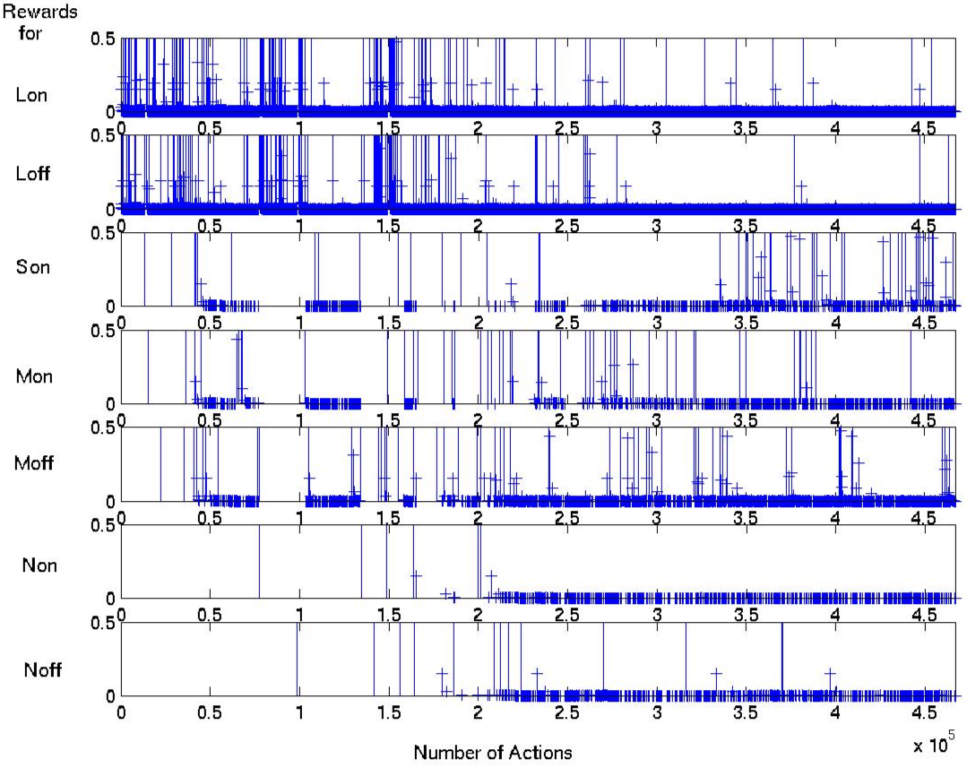
Reward for Salient Events
Lights
Sound
(bell)
Music
Monkey

Slide 25
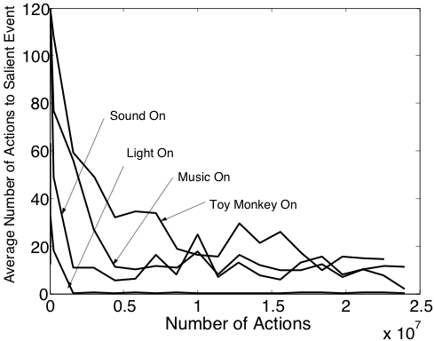
Speed of Learning Various Skills

Slide 26
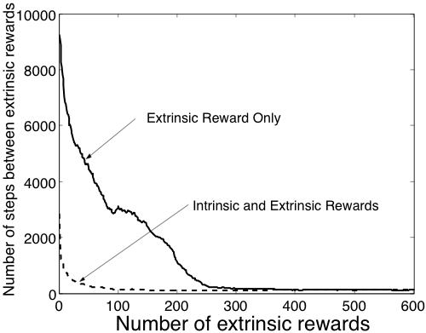
Learning to Make the Monkey Laugh

Slide 27
Shortcomings
Hand-crafted for our purposes
Pre-defined subgoals (based on “salience”)
Completely observable
Little state abstraction
Not very stochastic
No un-caused salient events
“Obsessive” behavior toward subgoals
Tries to use bad options
More

Slide 28
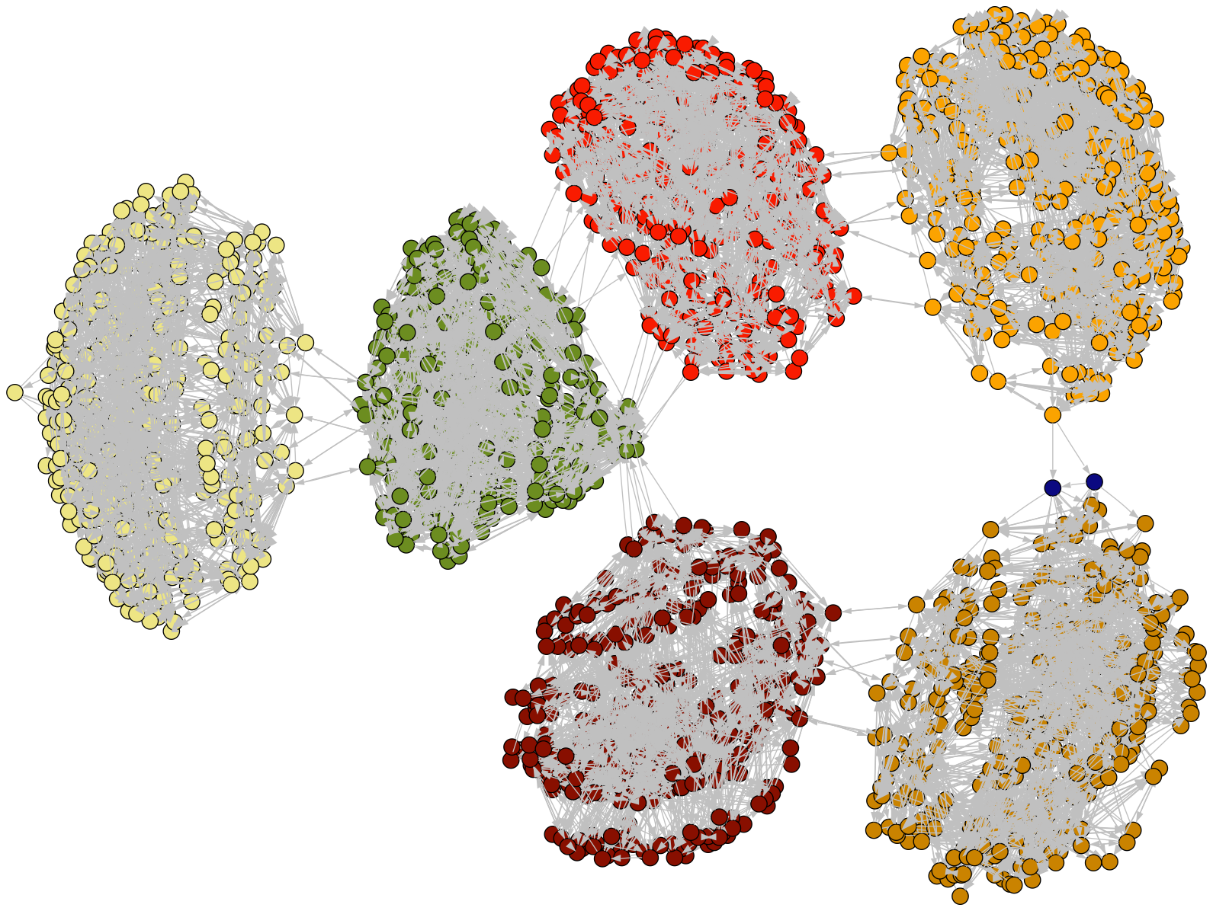
Connectivity of Playroom States
Özgür Şimşek
Light on
Music on
Noise off
Light off
Music on
Noise off
Light off
Music off
Noise off
Light on
Music off
Noise off
Light off
Music on
Noise on
Light on
Music on
Noise on

Slide 29
Conclusions
Need for smart adaptive generators
Adaptive generators grow hierarchically
Intrinsic motivation is important for creating behavioral building blocks
RL+Options+Intrinsic reward is a natural way to do this
Development!
Theory?
Behavior?
Neuroscience?

Slide 30
Intrinsically Motivated Reinforcement Learning: An Evolutionary Perspective. Singh, Lewis, Barto, and Sorg
Intrinsically Motivated Reinforcement Learning: A Promising Framework For Developmental Robot Learning. Stout, Konidaris, and Barto

Slide 31
What’s next? Please pick 1-5
Transfer Learning / lifelong learning: 2
Learning from Demonstration: 1
Multi-agent RL: 3
Options & Option Learning: 2
Game Playing: 2
Inverse Reinforcement Learning (IRL): 1
Learning in Robotics: 4
Meta-RL and empirical evaluation of algorithms: 1
Hierarchical Methods: 2
Case Studies: Robot soccer, Helicopter Control, etc.: 4
Adaptive Representations / Representation Learning: ☹
Partially observable environments and/or POMDPs: 1
Current Function Approximation Choices: 1
Efficient Model-Learning methods: 3
Other advanced RL methods (e.g., LSPI, policy gradient, etc.): 3
Crowd Sourcing: 1

