Slide 1
Any Questions?
Programming Assignments?

Slide 2
CptS 450/516
Singularity
Weka / Torch / RL-Glue/Burlap/RLPy
Finite MDP = ?
Start arbitrarily, moving towards the “truth”

Slide 3
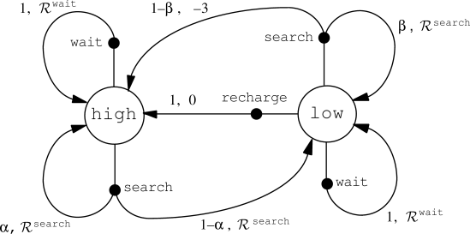

Slide 4
Notes:
Could listen to myself talk forever
1st part: agent to agent, but could be agent to human?
2nd part: human to agent, but could be agent to agent?

Slide 5
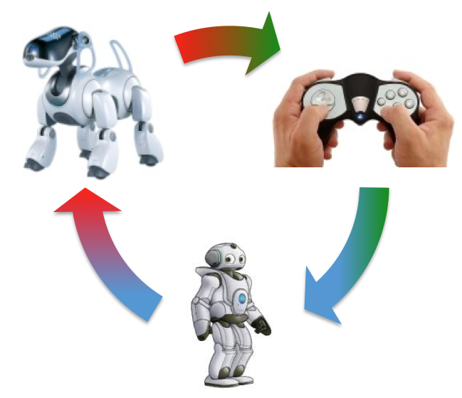
Transfer Learning
Transfer Learning with Probabilistic Mapping Selection
A. Fachantidis, I. Partalas, M. E. Taylor, I. Vlahavas
in Adaptive Behavior, 2014
Agents Teaching Agents
Reinforcement Learning Agents Providing Advice in Complex Video Games
M. E. Taylor, N. Carboni, A. Fachantidis, I. Vlahavas and L. Torrey
in Journal of Connection Science, 2014
Agents Teaching Humans
Agents Teaching Humans in Reinforcement Learning Tasks
Y. Zhan, A. Fachantidis, I. Vlahavas, and M. E. Taylor
in Adaptive and Learning Agents workshop (at AAMAS), 2014
Humans Teaching Agents
Generating Real-Time Crowd Advice to Improve Reinforcement Learning Agents
G. V. de la Cruz Jr., B. Peng, W. L. Lasecki, M. E. Taylor
in Workshop on Learning for General Competency in Video Games: tomorrow
Notes:
Could listen to myself talk forever
1st part: agent to agent, but could be agent to human?
2nd part: human to agent, but could be agent to agent?

Slide 6
Sutton & Barto, Chapter 4
Dynamic Programming

Slide 7
Review:
V, V*
Q, Q*
π, π*
Bellman Equation vs. Update

Slide 8
Solutions Given a Model
Finite MDPs
Exploration / Exploitation?
Where would Dynamic Programming be used?

Slide 9
“DP may not be practical for very large problems...” & “For the largest problems, only DP methods are feasible”
Curse of Dimensionality

Slide 10
Value Function
Existence and uniqueness guaranteed when
γ < 1 or
eventual termination is guaranteed from all states under π

Slide 11
Policy Evaluation: Value Iteration
Iterative Policy Evaluation
Full backup: go through each state and consider each possible subsequent state
Two copies of V or “in place” backup?

Slide 12
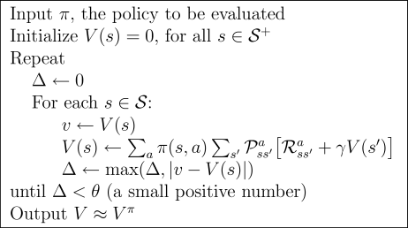
Policy Evaluation: Algorithm

Slide 13
Policy Improvement
Update policy so that action for each state maximizes V(s’)
For each state, π’(s)=?

Slide 14
Policy Improvement
Update policy so that action for each state maximizes V(s’)
For each state, π’(s)=?

