Slide 1
Salem, OR
4th owl attack in month

Slide 2
Any Questions?
Programming Assignments?

Slide 3
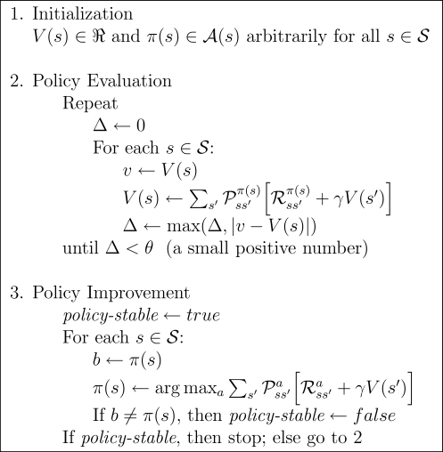
Policy Iteration
Convergence in limit

Slide 4
Policy Iteration: Policy Evaluation + Policy Improvement

Slide 5
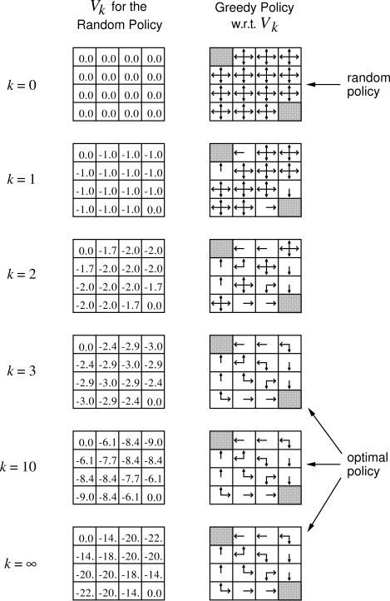
Policy Improvement: Examples
(Actions Deterministic,
Goal state(s) shaded)

Slide 6
Policy Improvement: Examples
4.1: If policy is equiprobably random actions, what is the action-value for Q(11,down)? What about Q(7, down)?
4.2a: A state (15) is added just below state 13. Its actions, left, up, right, and down, take the agent to states 12, 13, 14, and 15, respectively. Transitions from original states are unchanged. What is V(15) for equiprobable random policy?
4.2b: Now, assume dynamics of state 13 are also changed so that down takes the agent to 15. Now, what is V(15)?

Slide 7
Value Iteration: Update
Turn Bellman optimality equation
into an update rule

Slide 8
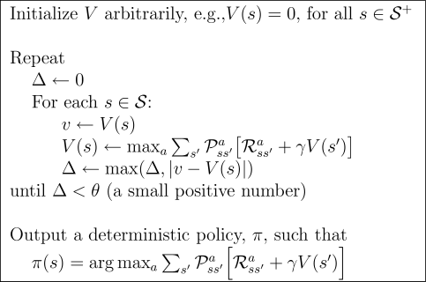
Value Iteration: algorithm
Why focus on deterministic policies?

Slide 13
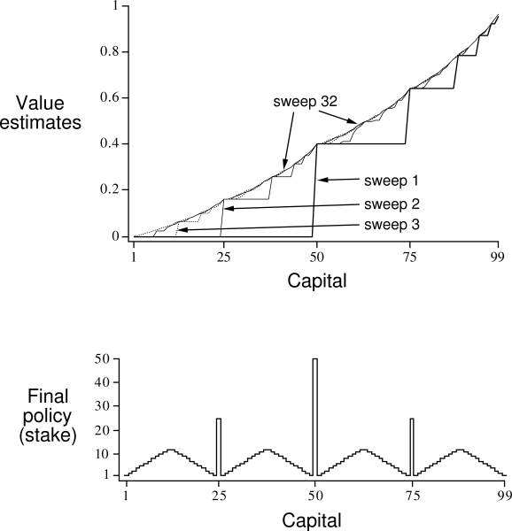
Gambler’s problem
Series of coin flips. Heads: win as many dollars as staked. Tails: lose it.
On each flip, decide proportion of capital to stake, in integers
Ends on $0 or $100
Example: prob of heads = 0.4

Slide 14
Gambler’s problem
Series of coin flips. Heads: win as many dollars as staked. Tails: lose it.
On each flip, decide proportion of capital to stake, in integers
Ends on $0 or $100
Example: prob of heads = 0.4

Slide 15
Asynchronous DP
Can backup states in any order
But must continue to back up all values, eventually
Where should we focus our attention?

Slide 16
Asynchronous DP
Can backup states in any order
But must continue to back up all values, eventually
Where should we focus our attention?
Changes to V
Changes to Q
Changes to π

Slide 17
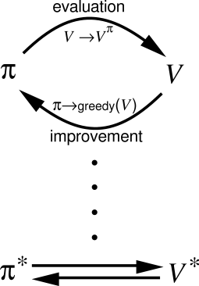
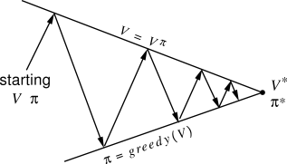
Generalized Policy Iteration

Slide 18
Generalized Policy Iteration
V stabilizes when consistent with π
π stabilizes when greedy with respect to V

Slide 19
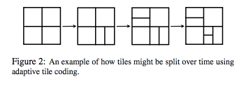
Aside
Variable discretization
When to Split
Track Bellman Error: look for plateaus
Where to Split
Which direction?
Value Criterion: Maximize the difference in values of subtiles = minimize error in V
Policy Criterion: Would the split change policy?

Slide 20
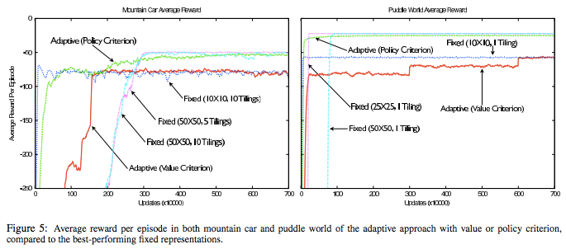

Slide 21
Optimal value function satisfies the fixed-point equation for all states x:
Define Bellman optimality operator:
Now, V* can be defined compactly:

Slide 22
T* is a maximum-norm contraction.
The fixed-point equation, T*V=V, has a unique solution
Or, let T* map Reals in X×A to the same, and:

Slide 23
Value iteration:
V_{k+1}=T*V_{k}, k≥0
Q_{k+1}=T*Q_{k}, k≥0
This “Q-iteration” converges asymptotically:
(uniform norm/supremum norm/Chebyshev norm)

Slide 24
Also, for Q-iteration, we can bound the suboptimality for a set number of iterations based on the discount factor and maximum possible reward

Slide 25
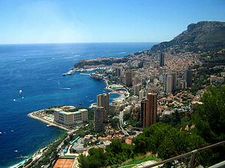
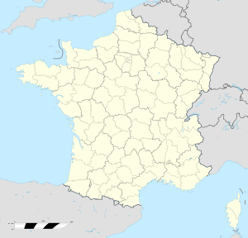
Monte Carlo
Administrative area in the Principality of Monaco
Founded in 1866, named “Mount Charles” after then-reigning price, Charles III of Monaco
1st casino opened in 1862, not a success

Slide 26
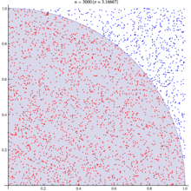
Monte Carlo Methods
Computational Algorithms: repeated random sampling
Useful when difficult / impossible to obtain a closed-form expression, or if deterministic algorithms won’t cut it
Modern version: 1940s for nuclear weapons program at Los Alamos (radiation shielding and neutron penetration)
Monte Carlo = code name (mathematician’s uncle gambled there)
Soon after, John von Neumann programmed ENIAC to carry out these calculations
Physical Sciences
Engineering
Applied Statistics
Computer Graphics, AI
Finance/Business
Etc.

