Slide 1
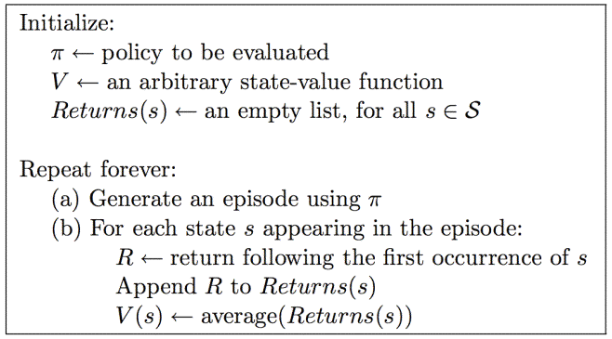
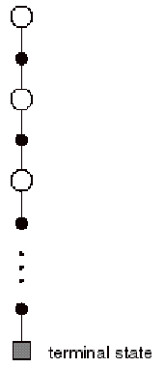
1st Visit MC for V^{π}
What about control?

Slide 2
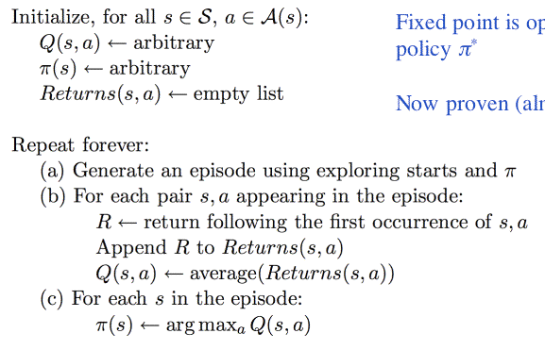
MC for Control (Exploring Starts)

Slide 3
Policy, Q(up), Q(down), Q(left), Q(right)
Deterministic transitions
Step reward = -0.1
Returns = {(7,U) = -1.2, (8, R) = -1.1}
7, U
3, L
R 0,0,.6,.7 | R 0,0,0,.8 | R 0,0,0,.9 | +1
U 0,0,0,0 |  | U 0,0,0,-1.1 | -1
U 0,0,0,0 | R 0,0,0,0 | R -1.2,0,0,0 | U 0,0,0,0

Slide 4
MC for Control, On-Policy
Soft policy:
π(s,a) > 0 for all s,a
ε-greedy
Can prove version of policy improvement for soft policies

Slide 5
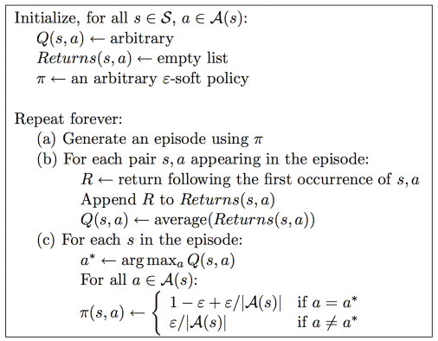
MC for Control, On-Policy

Slide 6
Off-Policy Control
Why consider off-policy methods?
Notes:
Learn about deterministic policy while exploring

Slide 7
Off Policy Control
Learn about π while following π’
Behavior policy vs. Estimation policy

Slide 8
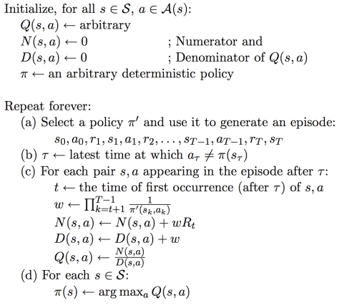

Slide 9
π’ = policy followed, π = policy evaluating
π’(s,a): probability that π’ will take action a
π(s,a)=1 b/c π is deterministic, and wouldn’t consider s,a if π didn’t select
First, we’re looking at tail of episode including the exploration action

Slide 10
R 0,0,.6,.7 | R 0,0,0,.8 | R 0,0,0,.9 | +1
U 0,0,0,0 |  | U 0,0,0,-1.1 | -1
U 0,0,0,0 | R 0,0,0,0 | R -1.2,0,0,0 | U 0,0,0,0

Slide 11
Off policy learning
Why only learn from tail?
Policy followed must infinite number of returns suitable for (c), e.g., ε-soft

Slide 12
Example: we’re considering some s,a and we eventually get return of 100. Say π’ is unlikely to reach this goal state: π’ is 0.01 on one of the steps to the goal (the rest are 1)
w = 100, N = 100*100, D = 100
Q = N/D = 100
Consider a different s’,a’, where we get a return of 100 but the goal state is always reached (π’ = 1.0 for all steps in the trajectory)
W = 1, N = 100, D = 1
Q = N/D = 100

Slide 13
Example: we’re considering some s,a and we eventually get return of 100. Say π’ is unlikely to reach this goal state: π’ is 0.01 on one of the steps to the goal (the rest are 1)
w = 100, N = 100*100, D = 100
Q = N/D = 100
Consider a different s’,a’, where we get a return of 100 but the goal state is always reached (π’ = 1.0 for all steps in the trajectory)
W = 1, N = 100, D = 1
Q = N/D = 100
Second: the difference here is how updates for these different s,a pairs will be calculated in the future. We have to weight the updates based on how likely we are to experience them based on the sampling policy.

Slide 14
http://www.eecs.wsu.edu/~taylorm/14_580/go.pdf
Achieving Master Level Play in 9×9 Computer Go
5 Minutes:
Summary of paper?
What’s interesting?
How could you improve their idea?

Slide 15
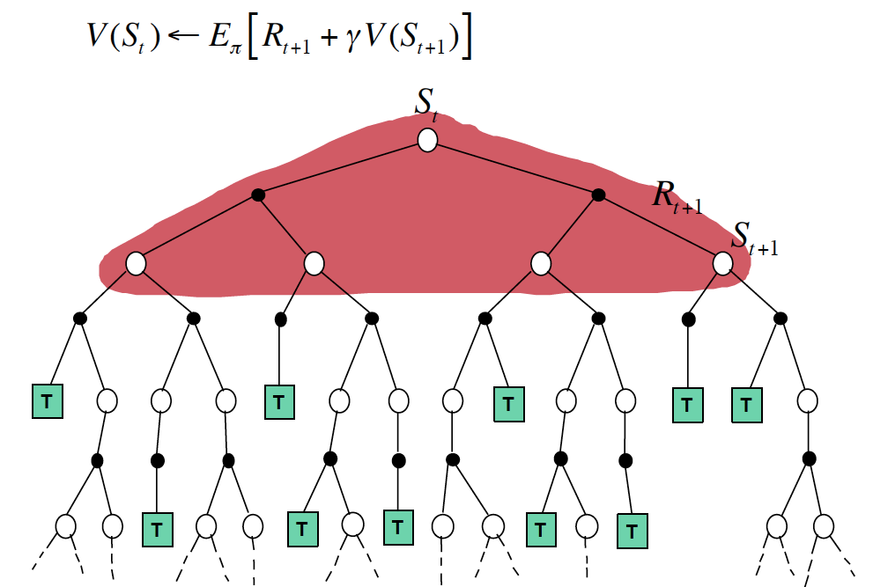

Slide 16
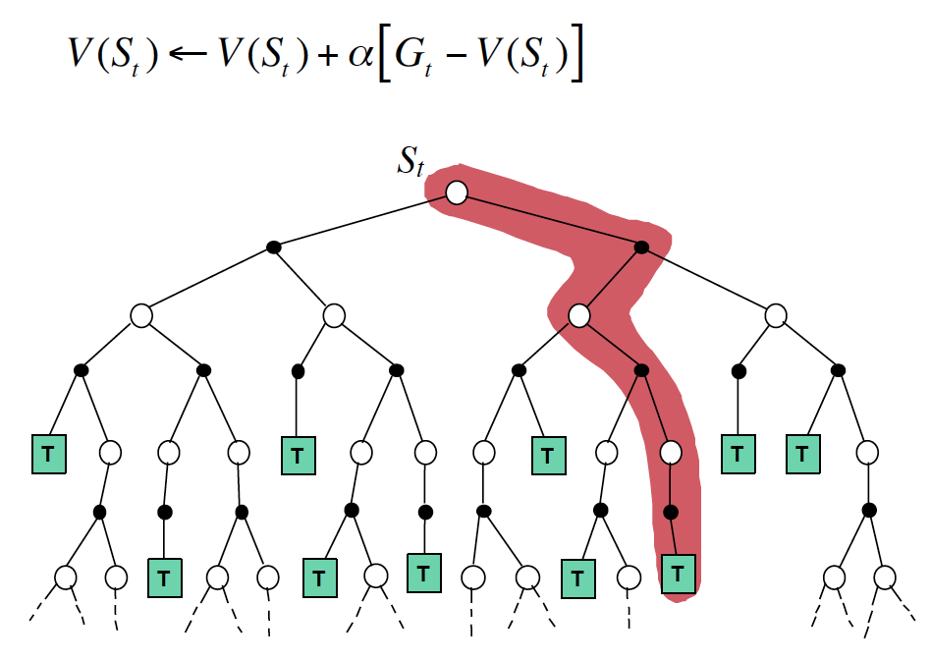

Slide 17
