Slide 1
RL2: Q(s,a) easily gets us U(s) and pi(s)
Leftarrow with alpha above = move towards target, weighted by learning rate
Sum of alphas is infinity, sum of squared alphas is less than infinity
Simulated annealing -> epsilon exploration
Combine random with greedy: exploration + exploitation
GLIE: Greedy limit + infinite exploration

Slide 2
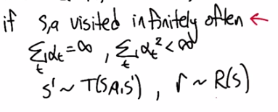
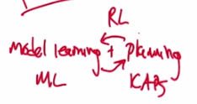

Slide 3
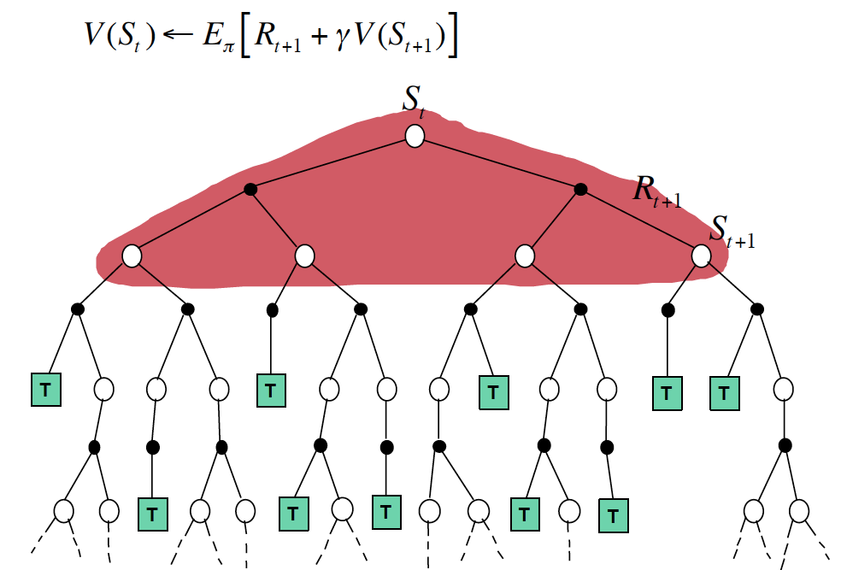

Slide 4
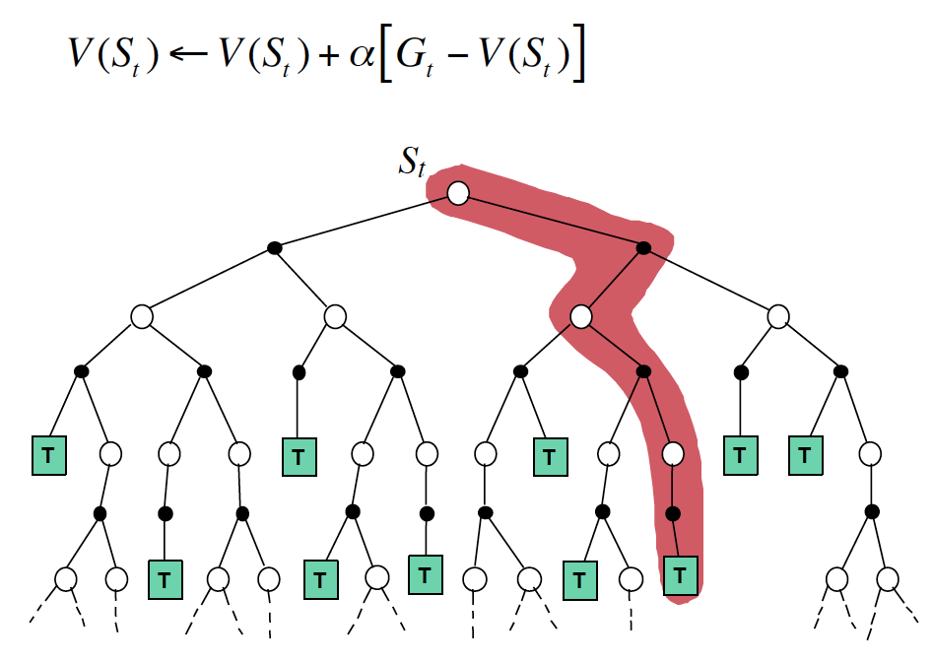

Slide 5
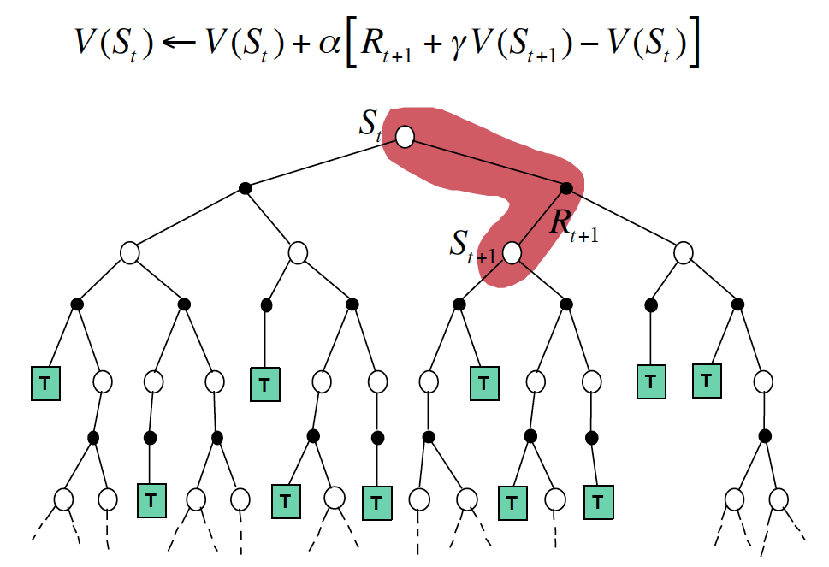

Slide 6
t, r -> planner -> policy Dyn. Prog.
s, a, s’, r -> learner -> policy Monte Carlo
s, a, s’, r -> modeler -> t,r
model -> simulate -> s, a, s’, r
Q-Learning ?
TD ?

Slide 8
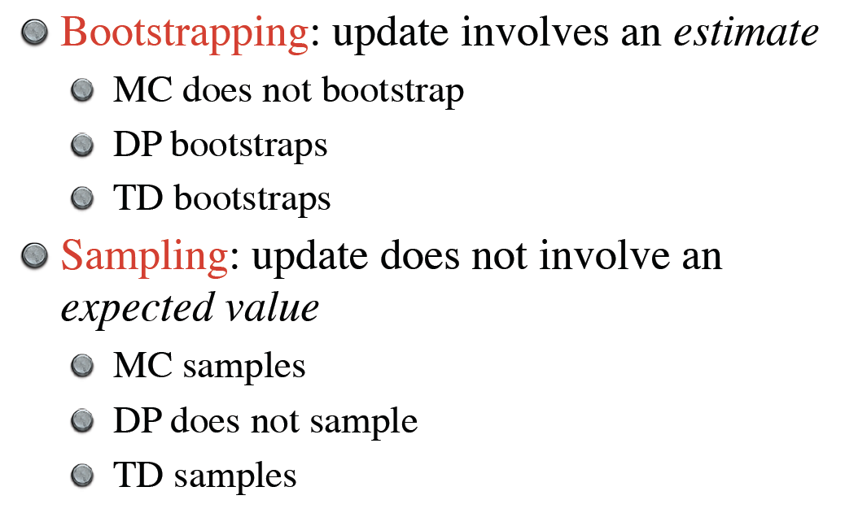

Slide 9
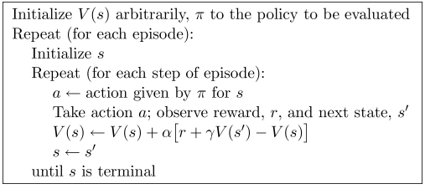

Slide 11
DP, MC, DP
Model, online/offline update, bootstrapping, on-policy/off-policy
Batch updating vs. online updating

Slide 12
Ex. 6.4
V(B) = ¾

Slide 13
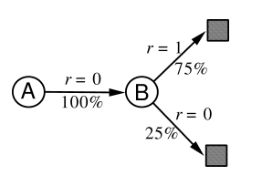
Ex. 6.4
V(B) = ¾
V(A) = 0? Or ¾?

Slide 15
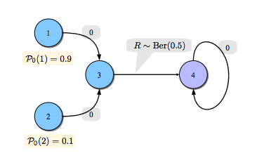
4 is terminal state
V(3) = 0.5
TD(0) here is better than MC for V(2). Why?

Slide 16
4 is terminal state
V(3) = 0.5
TD(0) here is better than MC. Why?
Visit 2 on the kth time, state 3 visited 10k times
Variance for MC will be much higher than TD(0) because of bootstrapping

Slide 17
4 is terminal state
V(3) = 0.5
Change so that R(3,a,4) was deterministic
Now, MC would be faster

Slide 18
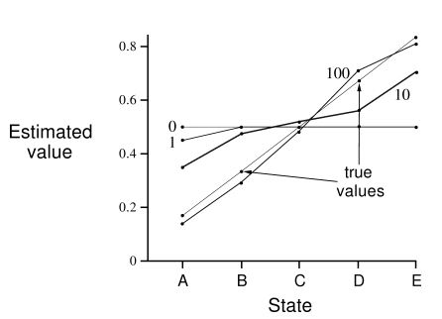
What happened in the 1st episode?

Slide 19
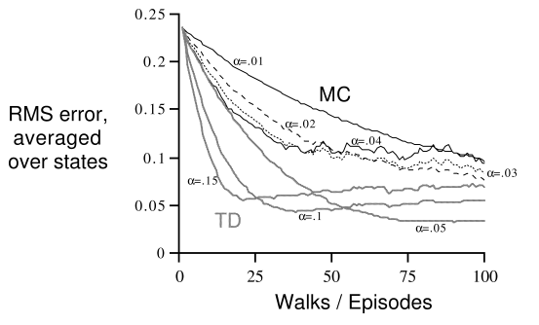
Ex 6.4, Figure 6.7. MC vs TD? TD RMS goes down and up again with high learning rates?

Slide 20
Ex 6.4, Figure 6.7. RMS goes down and up again with high learning rates. Would things change if you had a -1 on each step?

Slide 21
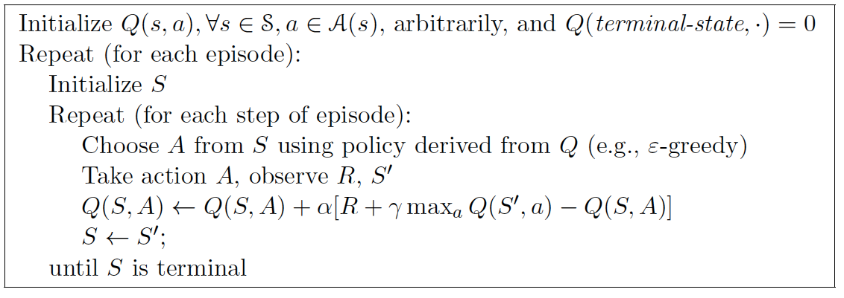
Q-Learning

Slide 23
Decaying learning rate?
Decaying exploration rate?

