Slide 1
Matching
®
Where am I on the global map?
Local Map
obstacle
Global Map















®


…

®


…








…


















Examine different possible robot positions.

Slide 2
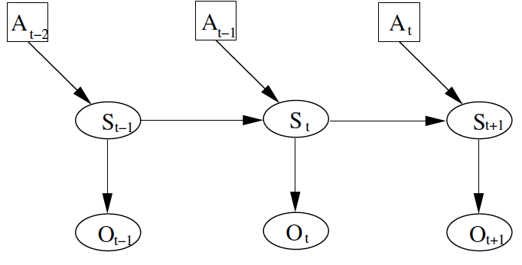
General approach:
A: action
S: pose
O: observation
Position at time t depends on position previous position and action, and current observation

Slide 3
Quiz!
If events a and b are independent,
    p(a, b) = p(a) × p(b)
If events a and b are not independent,
  p(a, b) = p(a) × p(b|a) = p(b) × p (a|b)
p(c|d) = p (c , d) / p(d) = p((d|c) p(c)) / p(d)

Slide 4
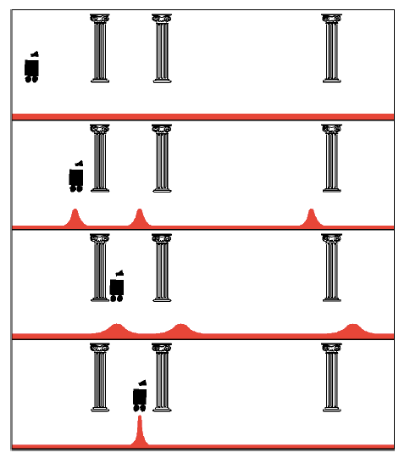
Uniform Prior
Observation: see pillar
Action: move right
Observation: see pillar

Slide 5
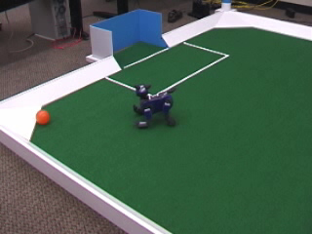
Modeling objects in the environment
http://www.cs.washington.edu/research/rse-lab/projects/mcl

Slide 6
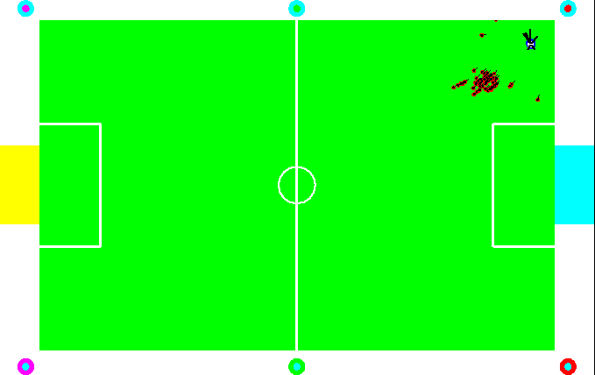
Modeling objects in the environment
http://www.cs.washington.edu/research/rse-lab/projects/mcl

Slide 7

Axioms of Probability Theory
$Pr⁡(A)$ denotes probability that proposition A is true.
$Pr⁡(¬A)$ denotes probability that proposition A is false.

Slide 8
A Closer Look at Axiom 3
B

Slide 9
Discrete Random Variables
X denotes a random variable.
X can take on a countable number of values in {x₁, x₂, …, x_{n}}.
P(X=x_{i}), or P(x_{i}), is the probability that the random variable X takes on value x_{i}.
P(x_{i}) is called probability mass function.
E.g.

Slide 10

Continuous Random Variables
$X$ takes on values in the continuum.
$p(X=x)$, or $p(x)$, is a probability density function.
E.g.
p(x)
x

Slide 11
Probability Density Function
p(x)
x
Since continuous probability functions are defined for an infinite number of points over a continuous interval, the probability at a single point is always 0.

Slide 12
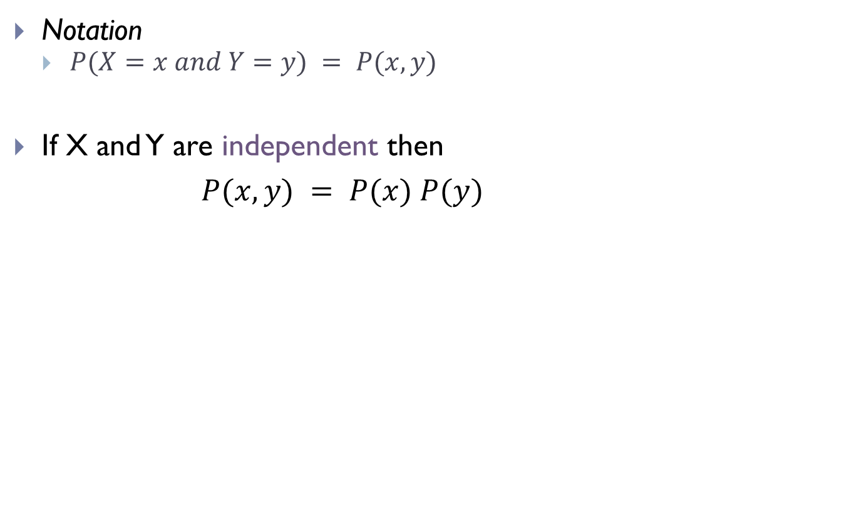
Joint Probability
Notation
  $P(X=x and Y=y) = P(x,y)$
If X and Y are independent then
$P(x,y) = P(x) P(y)$

Slide 13
Inference by Enumeration
What is the probability that a patient does not have a cavity, given that they have a toothache?
 | Toothache | ! Toothache
Cavity | 0.120 | 0.080
! Cavity | 0.080 | 0.720

Slide 14
Inference by Enumeration
What is the probability that a patient does not have a cavity, given that they have a toothache?
P (!Cavity | toothache) = P(!Cavity & Toothache) / P(Toothache)
 | Toothache | ! Toothache
Cavity | 0.120 | 0.080
! Cavity | 0.080 | 0.720

Slide 15
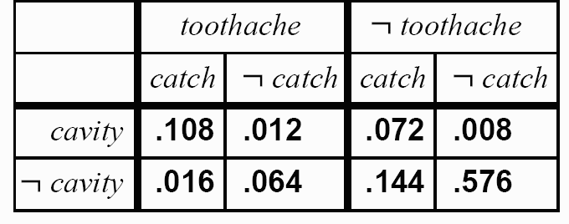
Inference by Enumeration
What is the probability that a patient does not have a cavity, given that they have a toothache?

Slide 16

Inference by Enumeration
  $P\left(¬cavity \right|toothache)=\frac{P(¬cavity∧toothache)}{P(toothache)}$
$\frac{0.016+0.064}{0.108+0.012++0.016+0.064}$ =0.4

Slide 17
Law of Total Probability
Discrete case
Continuous case

Slide 18
Bayes Formula
If y is a new sensor reading:
→
Prior probability distribution
→
Posterior (conditional) probability distribution
→
Model of the characteristics of the sensor
→
Does not depend on x

Slide 19
Bayes Formula

Slide 20
Normalization
Algorithm:

Slide 21
Conditioning
Law of total probability:

Slide 22
Bayes Rule with Background Knowledge

Slide 23
Conditional Independence
equivalent to
and

Slide 24
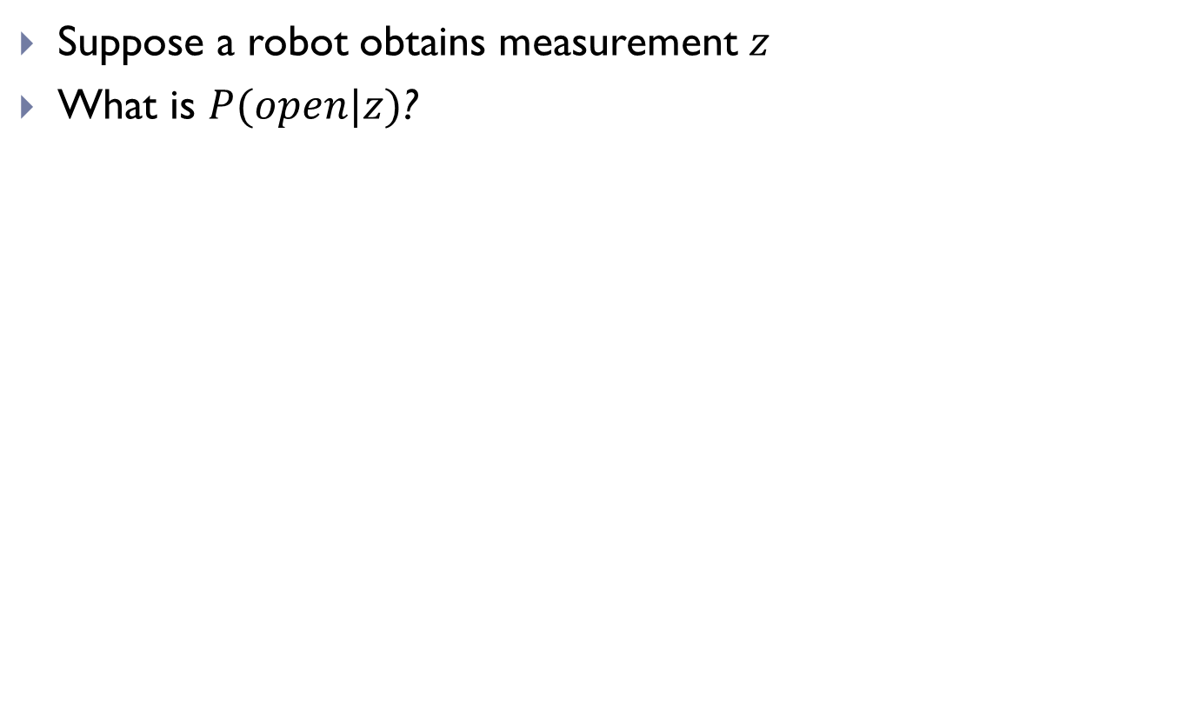
Simple Example of State Estimation
Suppose a robot obtains measurement $z$
What is $P(open|z)$?

Slide 25
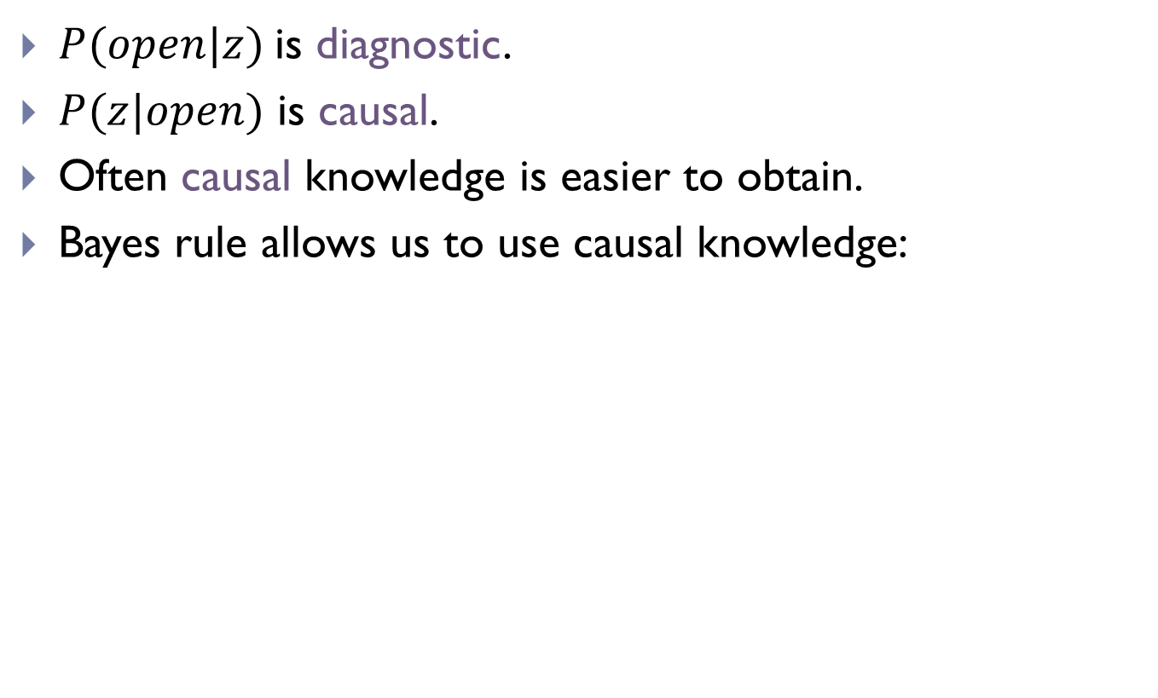
Causal vs. Diagnostic Reasoning
$P(open|z)$is diagnostic.
$P(z|open)$ is causal.
Often causal knowledge is easier to obtain.
Bayes rule allows us to use causal knowledge:
Comes from sensor model.

Slide 26
Example
P(z|open) = 0.6 P(z|¬open) = 0.3
P(open) = P(¬open) = 0.5
P(open | z) = ?

Slide 27
Example
P(z|open) = 0.6 P(z|¬open) = 0.3
P(open) = P(¬open) = 0.5
$z$ raises the probability that the door is open.

Slide 28

Combining Evidence
Suppose our robot obtains another observation z₂.
How can we integrate this new information?
More generally, how can we estimate
P(x| z₁...z_{n} )?

Slide 29
Recursive Bayesian Updating
Markov assumption: z_{n} is independent of z₁,...,z_{n-1} if we know x.

Slide 30
Example: 2nd Measurement
P(z₂|open) = 0.5 P(z₂|¬open) = 0.6
P(open|z₁)=2/3
$z2$lowers the probability that the door is open.

Slide 31
Localization
Gain Information
Lose
Information
Sense
Move
Initial Belief

Slide 32
Actions
Often the world is dynamic since
  actions carried out by the robot,
  actions carried out by other agents,
  or just the time passing by
change the world.
How can we incorporate such actions?

Slide 33
Typical Actions
Actions are never carried out with absolute certainty.
In contrast to measurements, actions generally increase the uncertainty.
(Can you think of an exception?)

Slide 34
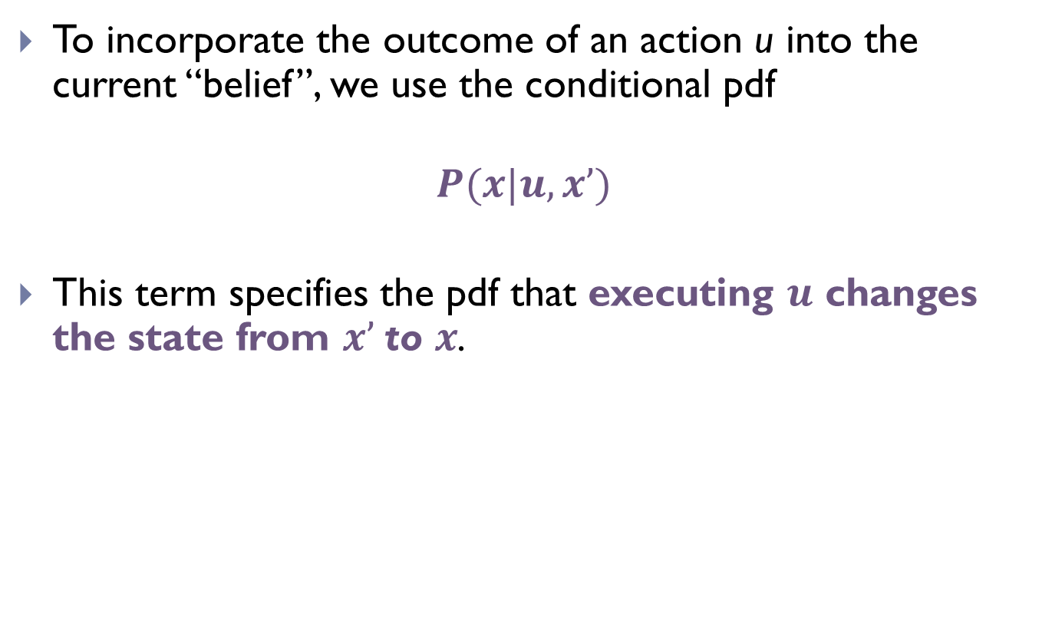
Modeling Actions
To incorporate the outcome of an action u into the current “belief”, we use the conditional pdf
$$P(x|u,x’)$$
This term specifies the pdf that executing $u$ changes the state from $x’$to $x$.

Slide 35
Example: Closing the door

Slide 36
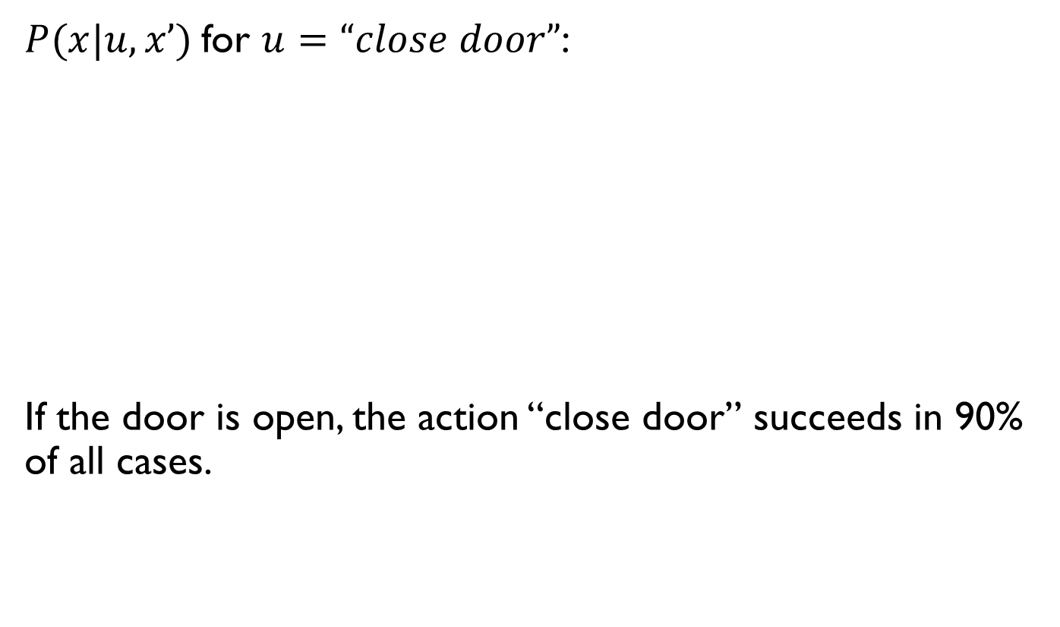
for :
If the door is open, the action “close door” succeeds in 90% of all cases.

Slide 37

Integrating the Outcome of Actions
Continuous case:
Discrete case:
$$P\left(closed | u\right)=P\left(closed | u,open\right)P\left(open\right)+$$
$P\left(closed | u, closed\right)P(closed)$
Applied to status of door, given that we just (tried to) close it?

Slide 38
Integrating the Outcome of Actions
Continuous case:
Discrete case:
$$P\left(closed | u\right)=P\left(closed | u,open\right)P\left(open\right)+$$
$P\left(closed | u, closed\right)P(closed)$
P(closed | u) = P(closed | u, open) P(open) + P(closed|u, closed) P(closed)

Slide 39
Example: The Resulting Belief

Slide 40
