Slide 1
Slides based on: Probabilistic Robotics http://www.probabilistic-robotics.org/ & Cyrill Stachniss http://ais.informatik.uni-freiburg.de/teaching/ws13/mapping/index_en.php
(Sensors on wheels)
Notes:
Sensors on wheels

Slide 5
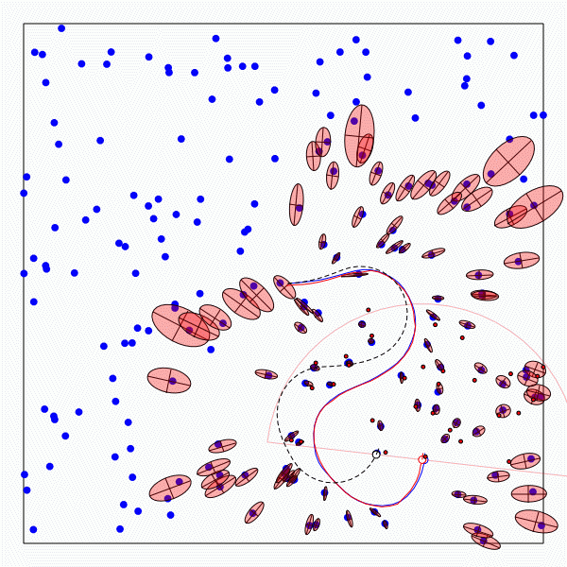
The SLAM Problem
A robot is exploring an unknown, static environment.
Given:
The robot’s controls
Observations of nearby features
Estimate:
Map of features
Path of the robot
Notes:
Fundamental!

Slide 6
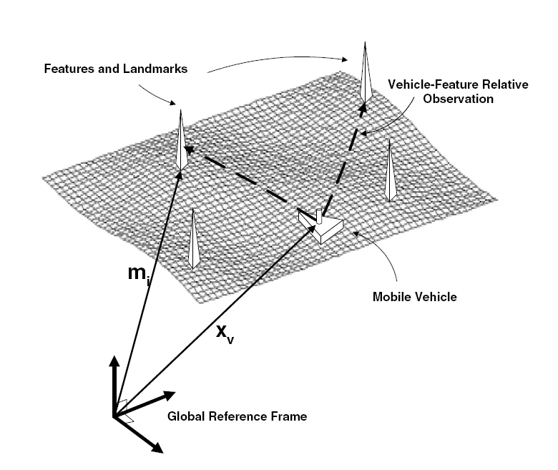
Structure of the Landmark-based SLAM-Problem

Slide 7
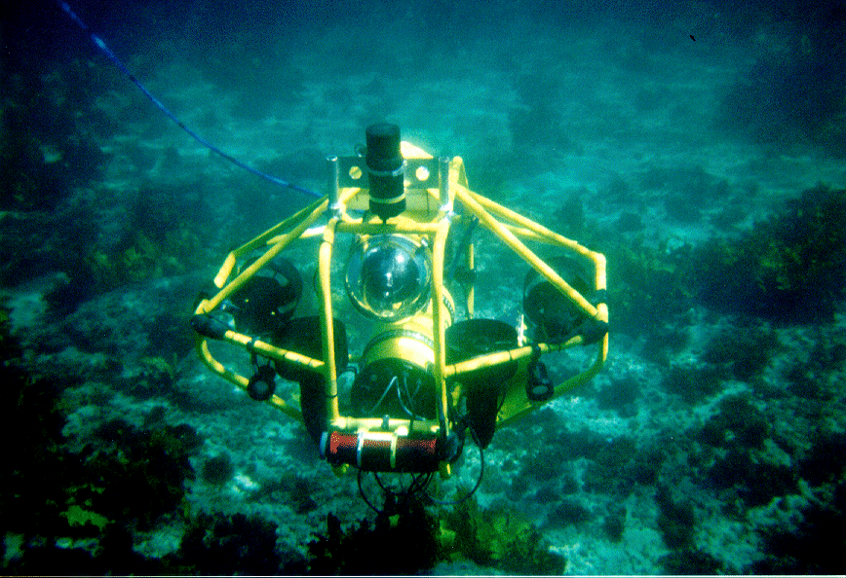
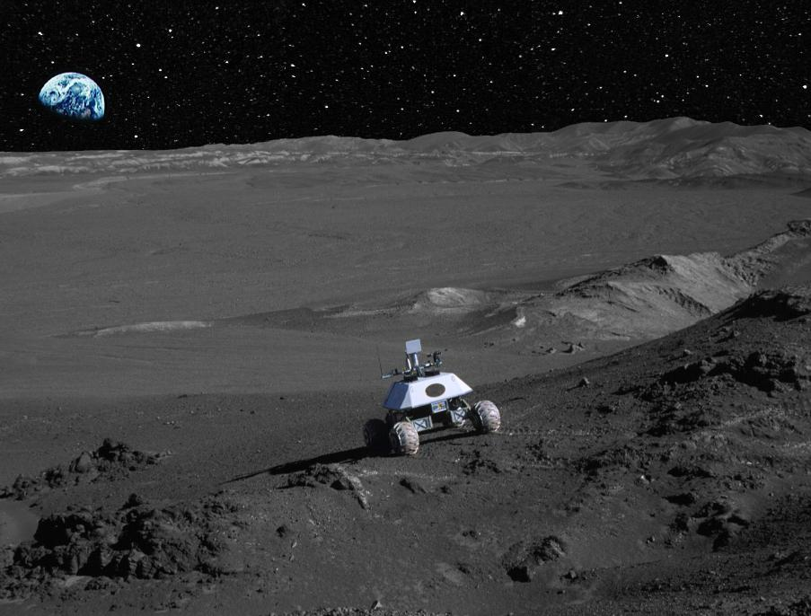
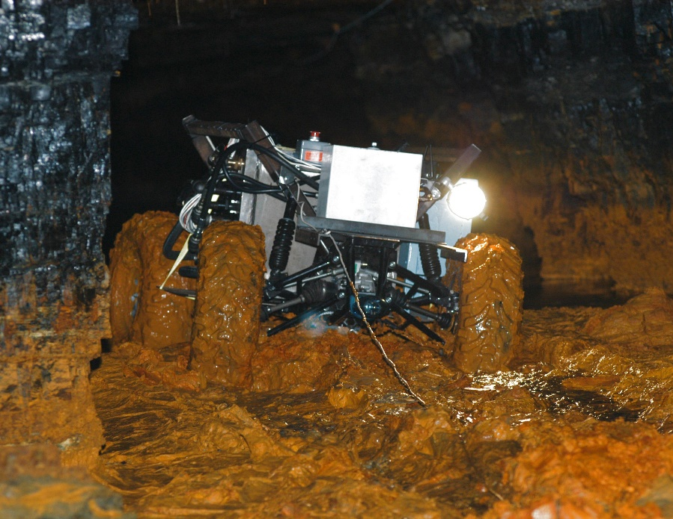
SLAM Applications
Indoors
Undersea
Space
Underground

Slide 8
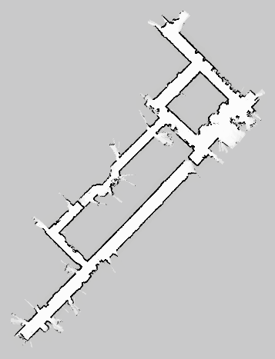
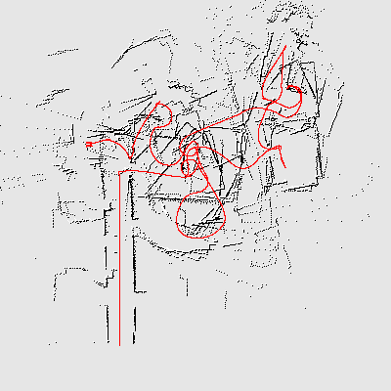
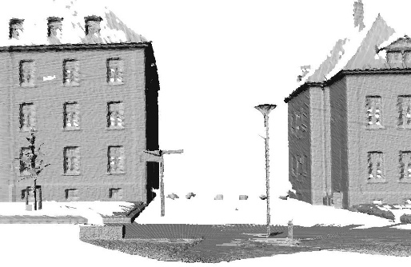
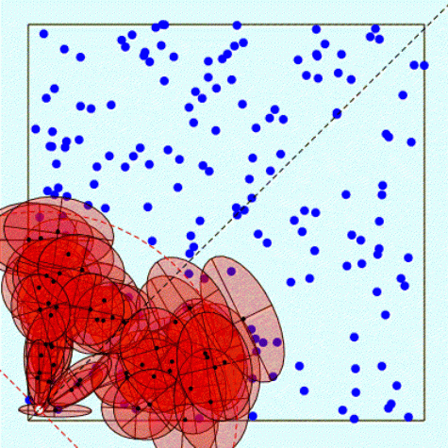
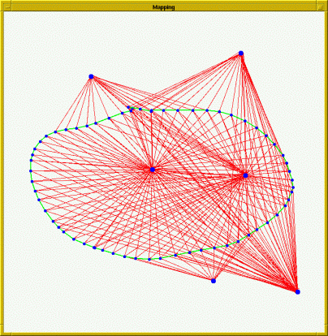
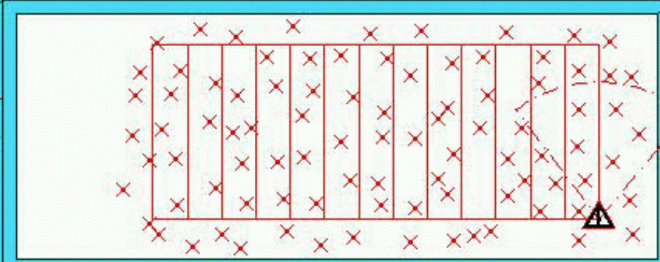
Representations
Grid maps or scans
[Lu & Milios, 97; Gutmann, 98: Thrun 98; Burgard, 99; Konolige & Gutmann, 00; Thrun, 00; Arras, 99; Haehnel, 01;…]
Landmark-based
[Leonard et al., 98; Castelanos et al., 99: Dissanayake et al., 2001; Montemerlo et al., 2002;…

Slide 9
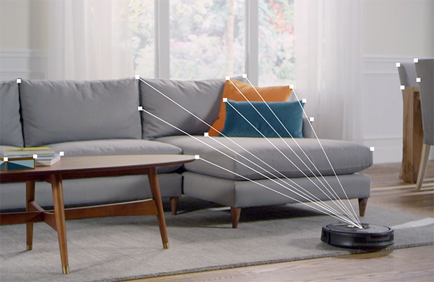
iRobot Roomba 980
Visual SLAM
http://spectrum.ieee.org/automaton/robotics/home-robots/irobot-brings-visual-mapping-and-navigation-to-the-roomba-980
https://www.youtube.com/watch?v=oj3Vawn-kRE

Slide 10
Why is SLAM a hard problem?
SLAM: robot path and map are both unknown
Robot path error correlates errors in the map

Slide 11
Why is SLAM a hard problem?
Robot pose
uncertainty
In the real world, the mapping between observations and landmarks is unknown
Picking wrong data associations can have catastrophic consequences
Pose error correlates data associations

Slide 14
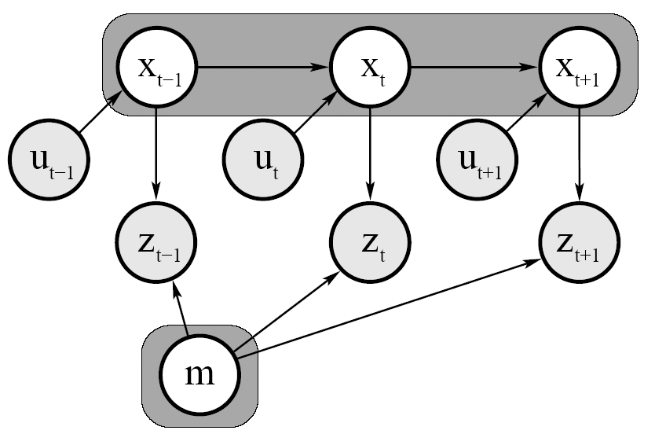
Graphical Model of Full SLAM:
Arrows = influences

Slide 15
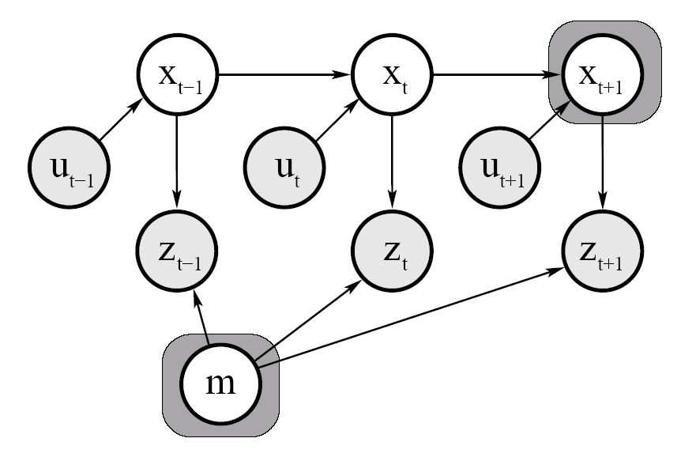
Graphical Model of Online SLAM:

Slide 16
SLAM: Simultaneous Localization and Mapping
Full SLAM:
Online SLAM:
Integrations typically done one at a time
Estimates entire path and map!
Estimates most recent pose and map!
Notes:
Reason over all previous possible positions by integrating them out (marginalizing out previous poses)

Slide 17
Notes:
Don’t represent everything
Able to tell features apart

Slide 21
Notes:
# hypotheses, amount of error handled

Slide 25
Kalman filter
Graph-based
Particle-based

Slide 27
P(x_{t} | x_{t-1}, u_{t})

Slide 28
P(z_{t} | x_{t})

Slide 29
Kalman Filter
μ’=μ+u
σ²’=σ²+r²
Sense
Move
Gaussian:
μ, σ²
Initial Belief

