Slide 1
EE489(Control Class)

Slide 2
Notes:
sigma, Sigma

Slide 3
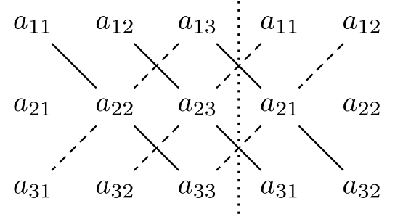
Square matrix: has inverse iff determinant != 0
Rule of Sarrus

Slide 11
How exact is this? Would it be sufficient for very precise control?

Slide 12
How will KF / EKF be used for SLAM?
What else could we use instead of KF / EKF?
Complexity: O(k^{2.4} + n²)
Notes:
K = dimensionality of observation
Matrix inversion (instead of cubic)
N = number of dimensions

Slide 14
1D implementation in Python

