Slide 1
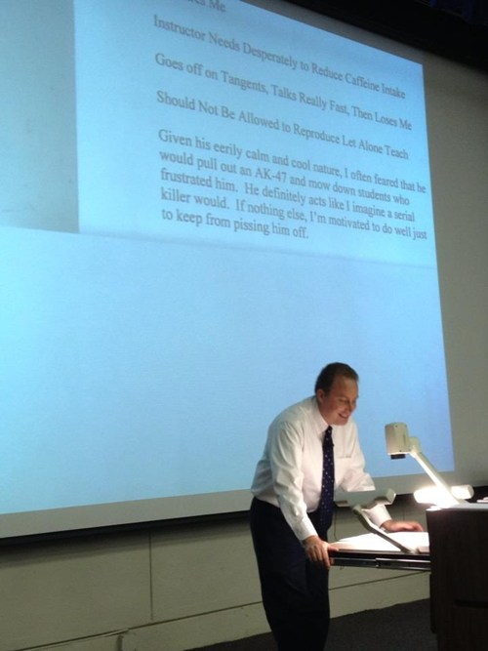

Slide 3
Turtlebots
Success!
Go through TurtleBot setup on the netbook
Make sure the netbook is updated: sudo apt-get dist-upgrade
Either use desktop machine, or ssh into desktop from your laptop
Configure the netbook .bashrc and the desktop .bashrc to make sure the IPs are correct
Update the kinect driver to use:
https://github.com/avin2/SensorKinect/zipball/unstable
Once you get it, unzip it
Execute sudo Platform/Linux/CreateRedist/install.sh
Then, install the driver (under Platform/Linux/Install)
Try out the demos!

Slide 4
Pizza Thu
Will send out a Doodle
Lactose intolerant? Etc.?

Slide 5
Mid-semester feedback
What do you think of the balance of theoretical vs. applied work?
More applied: 5.
Just right: 5.
(Would help to code complex ideas or don’t bother with them)
What’s been most useful to you (and why)?
Implementation: 7,
Homework: 2
What’s been least useful (and why)?
Complex theory that we’d not code (3)
(Last few weeks)
What could students do to improve the class?
Groups/team: 5
Use Piazza more: 2
What could Matt do to improve the class?
First few labs should be simpler (2)
More labs / exercises (5)
(More quizzes. I want to be in perpetual fear.)

Slide 6
Midterm
(Out of 93)
Average: 76.5 +/- 9.9
>80 | A
72-80 | A-
66-71 | B+
60-65 | B
56-60 | B-
53-57 | C+
<53 | C

Slide 7
Avg. | 1.7 | 0.6 | 1.5 | 0.9 | 4.2 | 3.6 | 4.1 | 3.5 | 4.4 | 3.9 | 11.6 | 13.1 | 14.1
Max. | 2.0 | 2.0 | 2.0 | 1.0 | 5.0 | 5.0 | 5.0 | 5.0 | 5.0 | 5.0 | 15.0 | 18.0 | 20.0
Std.Dev. | 0.7 | 0.9 | 0.9 | 0.4 | 1.2 | 1.5 | 0.9 | 1.7 | 1.2 | 1.5 | 3.2 | 4.3 | 5.7

Slide 8
1pm
UW Visitor
Environmental Challenge
Business Challenge
But, I have a PhD thesis proposal that got scheduled for same time

Slide 9
Lab 4
You will need to write functions to drive the turtlebots. Get into groups and figure out how to start.
Suggestions:
Explore the turtlebot_teleop ROS package
Figure out how you’d make a node that could publish Twist messages to the cmd_vel_mux/input/telop topic
Figure out how you’d make a node that could subscribe to Odometry messages (check out turtlebot/src/kobuki/kobuki_node)

