Slide 1








Slide 2
Reminders
Lab due Sun Night
Matt out of town Thu, but lab open at noon
  Also open T/W/Th evenings
  Also open ~1pm on Sunday (robosub meeting)
Next week (by 11:59pm on Monday): send Matt short description of proposed project. What are the deliverables? What are the success conditions?

Slide 3
Optimization and Learning
… more coming to WSU

Slide 4
Parameter Optimization
Robotic systems have many parameters
  Control parameters
  Odometry parameters
  Kalman filter parameters
  Behavior primitives
  …
How can we optimize these in an efficient way?

Slide 5
Local Search
Operates by keeping track of only the current state and changing that state to (hopefully) improve performance
Often used for:
  Optimization problems
  Scheduling
  Task assignment
  …many other problem where the goal is to find the best state according to some objective function

Slide 6
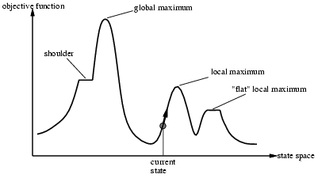
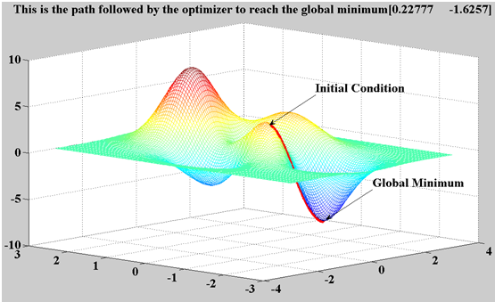
Local Search
Goal is to find the local maximum (or minimum)
Example:
  # seconds to spin wheels at 1.0 to move 2.0 meters.
  Others?

Slide 7
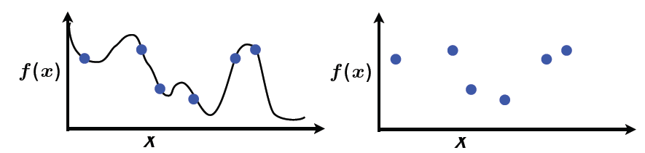
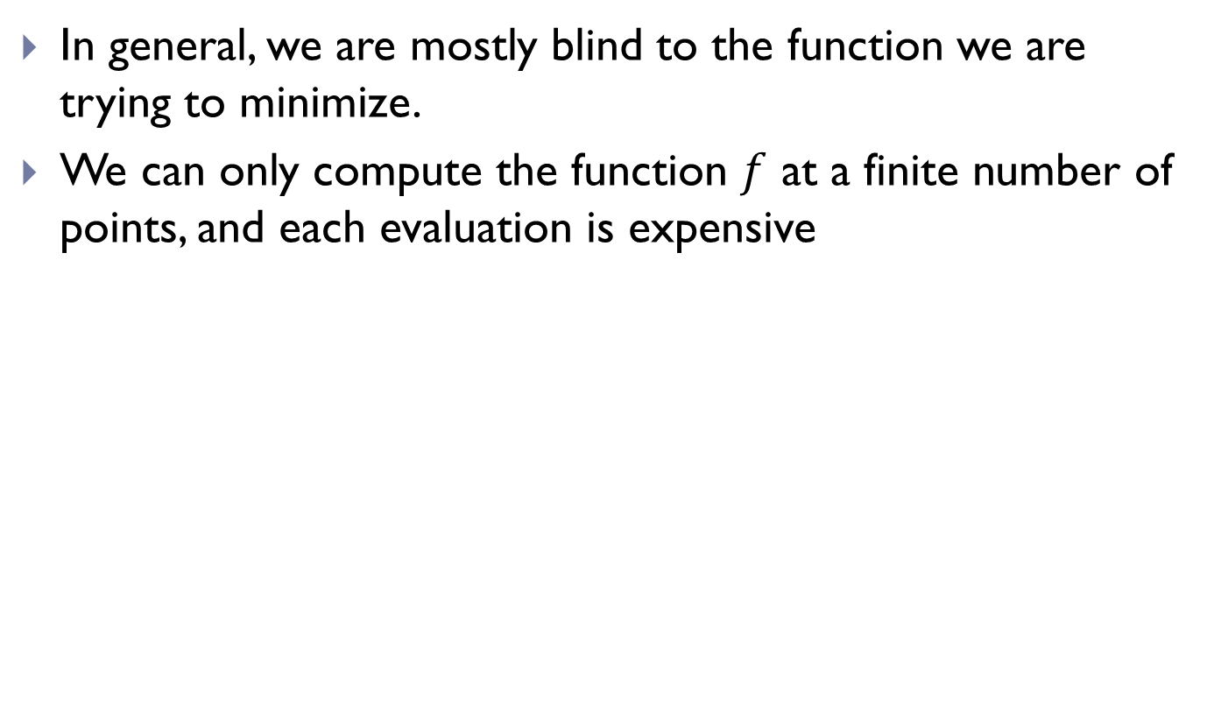
Local Search
In general, we are mostly blind to the function we are trying to minimize.
We can only compute the function $f$ at a finite number of points, and each evaluation is expensive
True Function
Observed Function

Slide 8
Gradient Descent
Minimum is found by following the slope of the function
“Like climbing Everest in thick fog with amnesia”

Slide 9
Gradient Descent
Start with a point (guess)
Repeat
  Determine a descent direction
  Choose a step
  Update
Until stopping criterion is satisfied

Slide 10
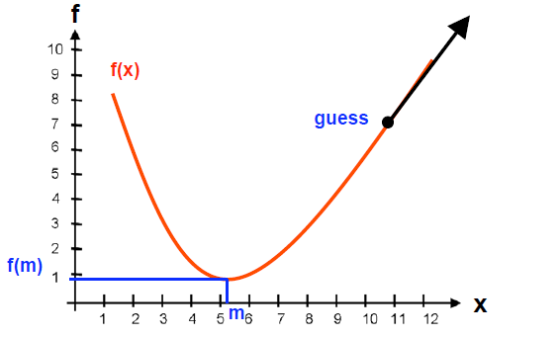

Slide 11
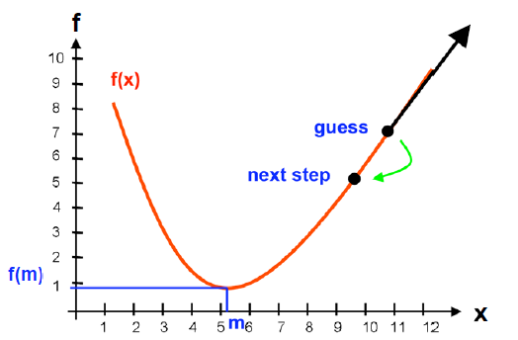

Slide 12
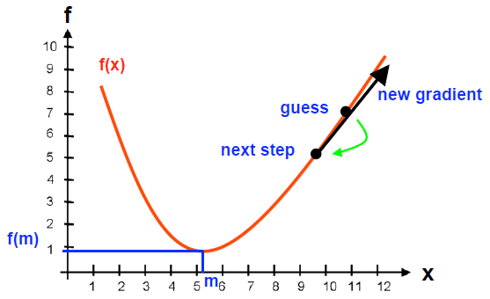

Slide 13
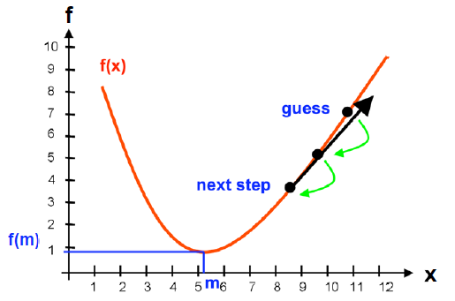

Slide 14
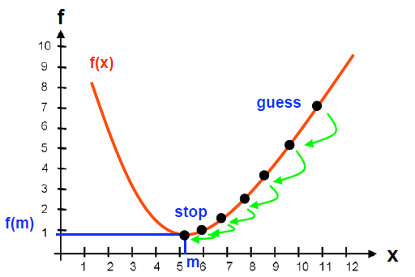

Slide 15
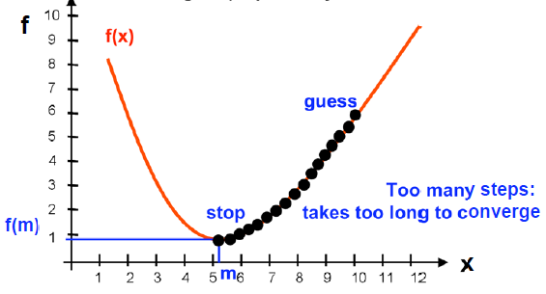
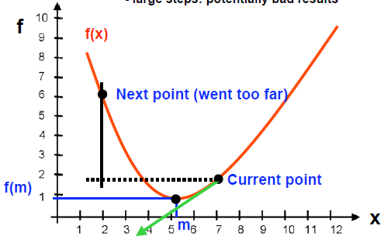
Parameters
Step size
  Small steps: inefficient
  Large steps: potentially bad results

Slide 16
Gradient Descent - Benefits
  Efficient for multidimensional domains (if you know the gradient)
  Well-suited for smooth objective and constraint functions

Slide 17
Gradient Descent - Drawbacks
  Convergence is only local; gets stuck at local minima and plateaus
    Mitigated by using multiple starting points to find multiple local minima, and hopefully the global minimum
    Other ideas for plateaus?
  Not well-suited for discrete optimization
    Other methods work better for discrete domains

Slide 18

What if we don’t know $f$ and the gradient?
Estimate the partial derivative w.r.t. each dimension using sampling
Take the current estimate at x
Create k new estimates
Evaluate each estimate using objective function f
Estimate gradient of objective function of f at x

Slide 19
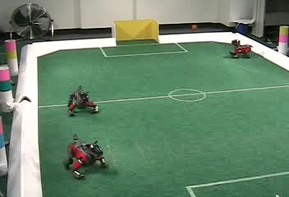
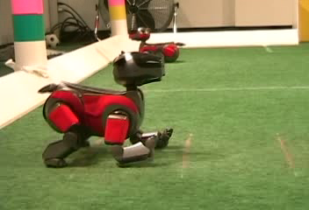

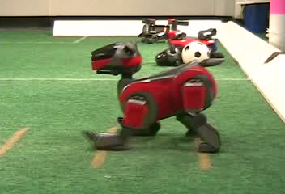
Robot Gait Learning through Gradient Descent
Experimental Setup
Initial Gait
Part Way Through
Final Gait

Slide 20
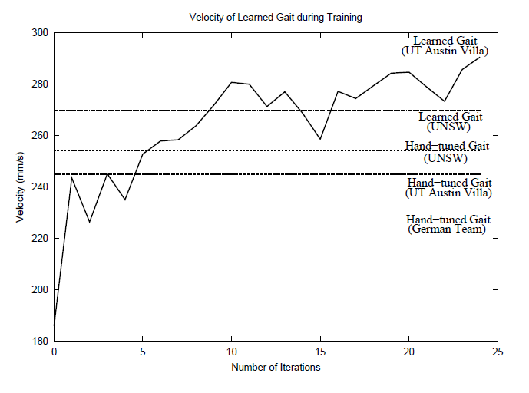
Learning Performance

Slide 21
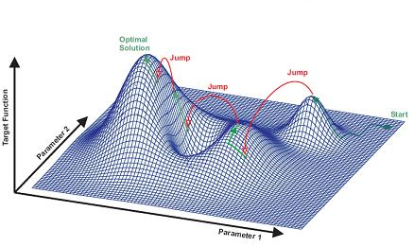
Simulated annealing search
Improves on gradient descent
Idea: escape local maxima by allowing some “bad” moves but gradually decrease their frequency

Slide 22
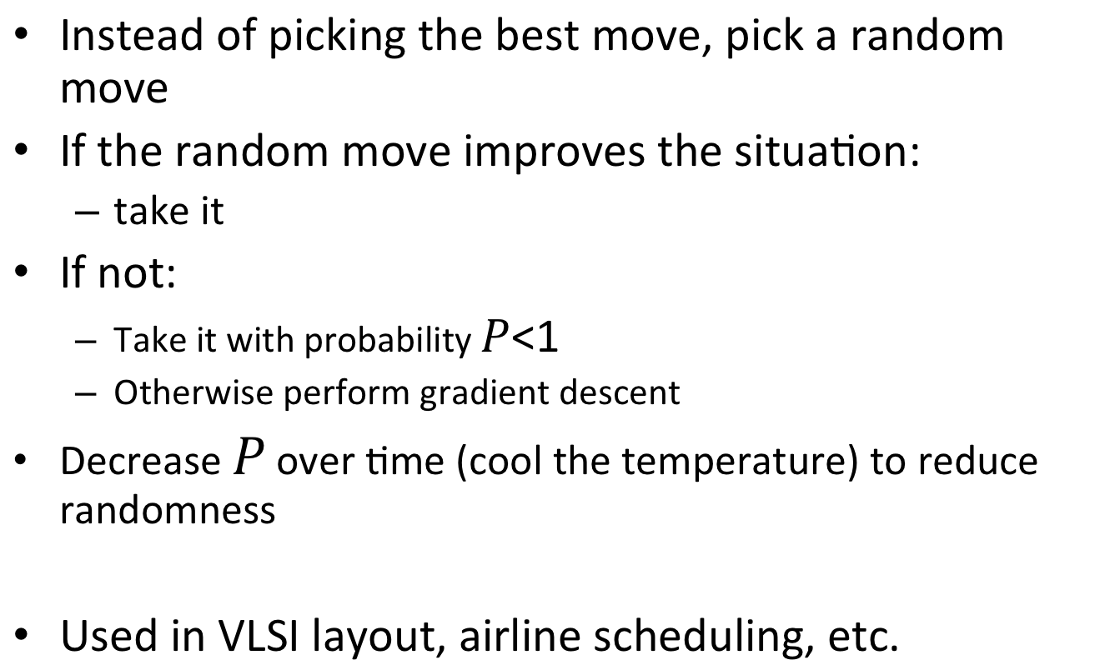
Simulated annealing search
Instead of picking the best move, pick a random move
If the random move improves the situation:
  take it
If not:
  Take it with probability
  Otherwise perform gradient descent
Decrease over time (cool the temperature) to reduce randomness
Used in VLSI layout, airline scheduling, etc.

Slide 23
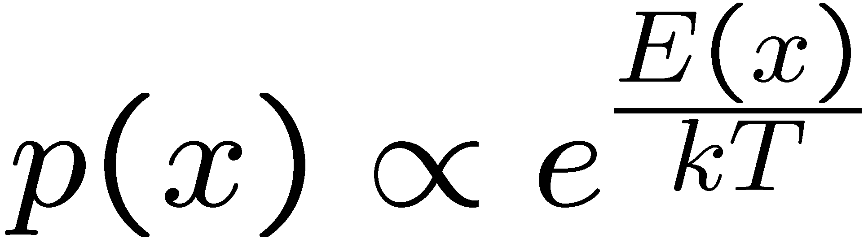
Simulated Annealing
Theoretical guarantee:
  Stationary distribution:
  If T decreased slowly enough,
  will converge to optimal state!
Is this an interesting guarantee?
Sounds like magic, but reality is reality:
  The more downhill steps you need to escape, the less likely you are to ever make them all in a row
  People think hard about ridge operators which let you jump around the space in better ways

Slide 24
“many real world problems have a landscape that looks more like a widely scattered family of balding porcupines on a flat floor, with miniature porcupines living on the tip of each porcupine needle, ad infinitum.”
    -Russell and Norvig

Slide 25
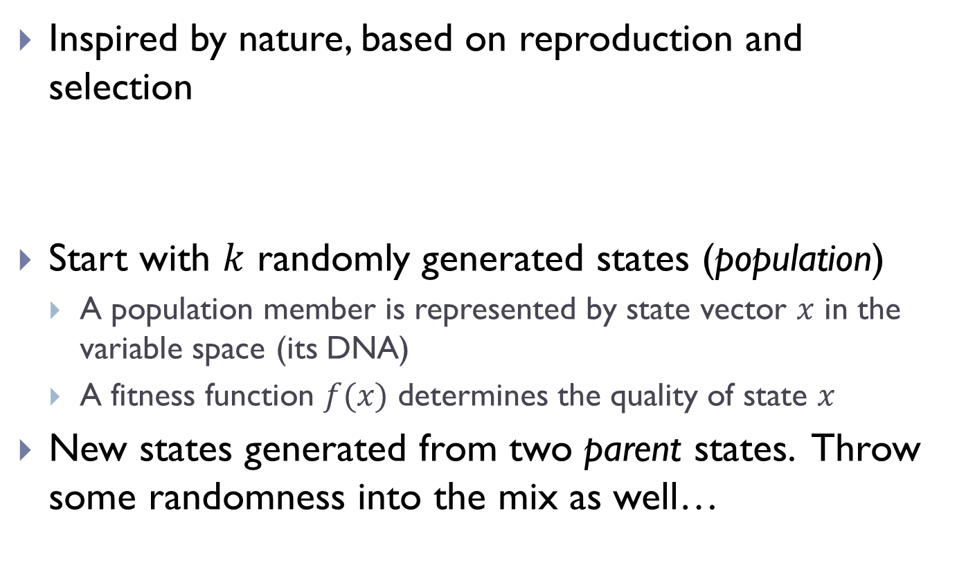
Genetic Algorithms
Inspired by nature, based on reproduction and selection
Start with randomly generated states (population)
  A population member is represented by state vector in the variable space (its DNA)
  A fitness function determines the quality of state
New states generated from two parent states. Throw some randomness into the mix as well…

Slide 26
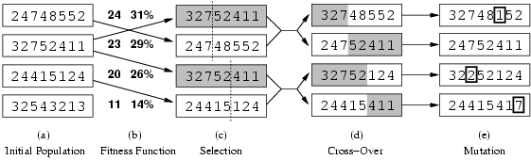
Genetic algorithms

Slide 27
Genetic algorithms
Normalized fitness function:
  24/(24+23+20+11) = 31%
  23/(24+23+20+11) = 29%
  … etc.

Slide 28
Genetic algorithms
Probability of selection is weighted by the normalized fitness function.

Slide 29
Genetic algorithms
Probability of selection is weighted by the normalized fitness function.

Slide 30
Genetic algorithms

Slide 31
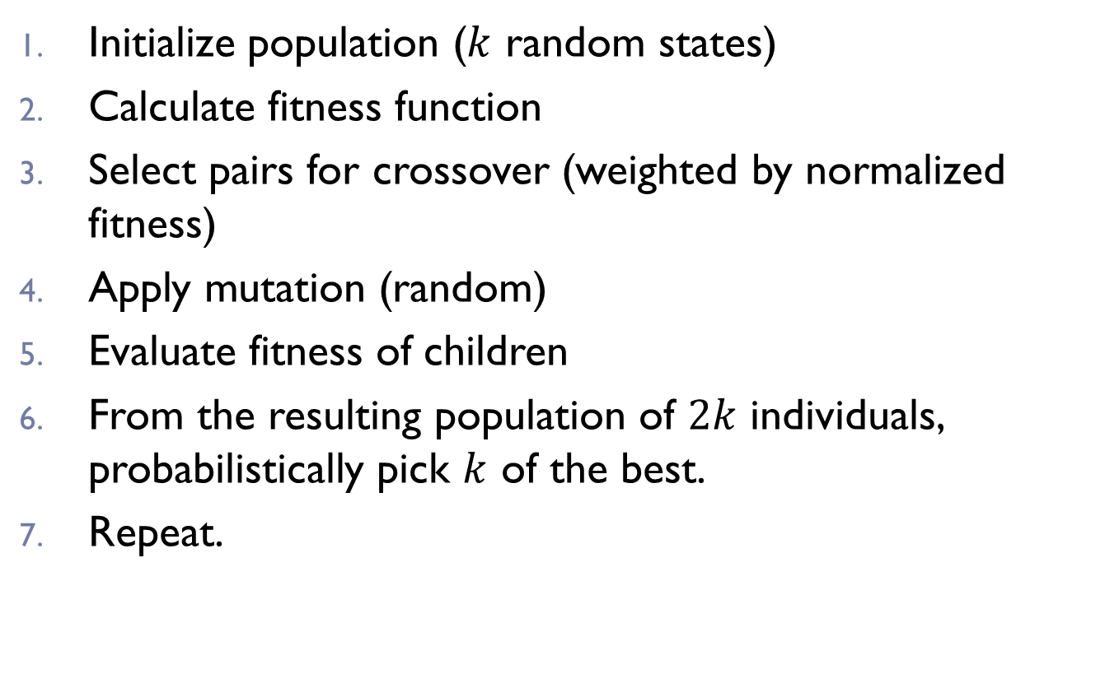
Genetic Algorithms
Initialize population ( random states)
Calculate fitness function
Select pairs for crossover (weighted by normalized fitness)
Apply mutation (random)
Evaluate fitness of children
From the resulting population of individuals, probabilistically pick of the best.
Repeat.

Slide 32
Example: N-Queens
Why does crossover make sense here?
When wouldn’t it make sense?
What would mutation be?
What would a good fitness function be?

Slide 33
Genetic Algorithms
Compared to gradient-based methods:
  Can perform similar random jumps to simulated annealing
  Greater coverage - multiple state estimates at a time
  Less sensitive to local optima
  Can be used for both continuous and discrete variables

Slide 34
Neural Network Learning
Learning approach based on modeling adaptation in biological neural systems.
Perceptron: Initial algorithm for learning simple neural networks (single layer) developed in the 1950’s.
Backpropagation: More complex algorithm for learning multi-layer neural networks developed in the 1980’s.

Slide 35
Artificial Neuron Model
Model network as a graph with cells as nodes and synaptic connections as weighted edges from node i to node j, w_{ji}
Model net input to cell as
Cell output is:
1
w₁₂
w₁₅
w₁₆
w₁₃
w₁₄
2
3
4
5
6
o_{j}
1
(T_{j} is threshold for unit j)
0
T_{j}
net_{j}

Slide 36
Neural Computation
McCollough and Pitts (1943) showed how such model neurons could compute logical functions and be used to construct finite-state machines.
Can be used to simulate logic gates:
  AND
  OR
  NOT
Can build arbitrary logic circuits, sequential machines, and computers with such gates.
Given negated inputs, two layer network can compute any boolean function using a two level AND-OR network.
Notes:
Let all w_{ji} be T_{j} / n,
Let all w_{ji} be T_{j} where n is the number of inputs.
Let threshold be 0, single input with a negative weight.

Slide 37
Perceptron as Hill Climbing
The hypothesis space being search is a set of weights and a threshold.
Objective is to minimize classification error on the training set.
Perceptron effectively does hill-climbing (gradient descent) in this space, changing the weights a small amount at each point to decrease training set error.
For a single model neuron, the space is well behaved with a single minima.
training
error
0
weights

Slide 38
Multi-Layer Networks
Multi-layer networks can represent arbitrary functions, but an effective learning algorithm for such networks was thought to be difficult.
A typical multi-layer network consists of an input, hidden and output layer, each fully connected to the next, with activation feeding forward.
The weights determine the function computed. Given an arbitrary number of hidden units, any boolean function can be computed with a single hidden layer.
output
hidden
activation
input

Slide 39
Neural Network Action Selectors
Used by Neuroevolution techniques
x₁ x₂
x₃
s
a₂

Slide 40
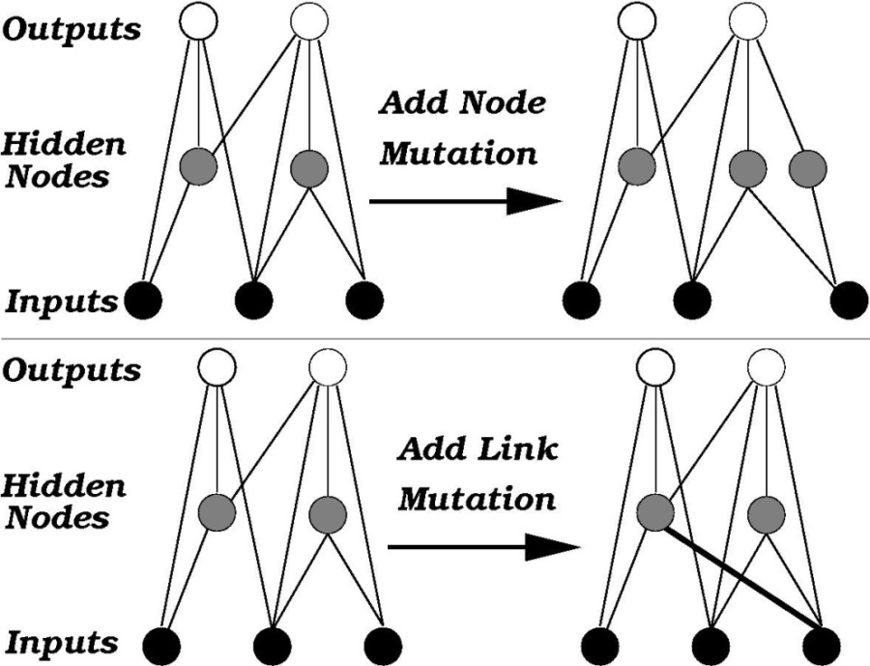
NEAT [Stanley, Miikkulainen, ‘02]
NeuroEvolution of Augmenting Topologies:
  Evolves neural networks with a genetic algorithm
Evaluate each policy in population via fitness function
Generate new population via:
  Mutation
  Genetic crossover
  Adding nodes
  Adding links
Learns Action Selectors
Notes:
Crossover isn’t standard
Assume EC is familiar but that adding nodes/links isn’t

Slide 41
Fitness function
Population, lots of parameters
Types of problems can solve
  http://nn.cs.utexas.edu/pages/research/rocket/
  http://nerogame.org/
Co-evolution
  http://www.cs.utexas.edu/users/nn/pages/research/neatdemo.html
  http://www.cs.utexas.edu/users/nn/pages/research/robotmovies/clip7.gif
Where will GAs not do as well in robotics (or in general)?

