Slide 1
Logistics: Matt Taylor

Slide 3
Real World Environment
Motion Control
Perception
Path
Environment Model, Local Map
Cognition
Position
Global Map
Localization

Slide 4
How would you design the “architecture” for a robot?
  Considerations?
  Inputs/outputs?

Slide 5
How would you design the “architecture” for a robot?
  Considerations?
  Inputs/outputs?
Think Cpt_S 260. What’s similar? What’s different?

Slide 6
Robot Software Architectures
Principled design for software modules that control a mobile robot system.
Advantages:
  Modularity
    code reuse and sharing
  Control localization within the architecture
    Individual component testing
    Optimization through learning

Slide 7
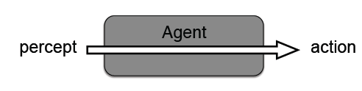
Reactive Architecture
actions are directly triggered by sensors
  no representations of the environment
  predefined, fixed response to a situation
  fast response to changes in the environment

Slide 8
Limitations of a Reactive Robot
Knowledge of the world is limited by the range of its sensors
Unable to count (how could you get around this?)
Unable to recover from actions which fail silently
Can not “undo” an incorrect action
Not possible to “plan ahead”
Can not coordinate with other robots in a reasonable way
many others ...

Slide 9
Deliberative Architectures
Organized by decomposing the required system functionality into concurrent modules or components.
  Map building
  Path planning
  Navigation
  …
Problems:
  overall complexity of the system may grow
  hard to offer real-time guarantees on performance:
    solving any given problem takes longer than an equivalent reactive implementation
    solving different problems takes different amounts of time

Slide 10
Architecture Decomposition
Decomposition allows us to modularize our control system based on different axes:
Temporal Decomposition
  Facilitates varying degrees of real-time processes
Control Decomposition
  Defines how modules should interact: serial or parallel?

Slide 11
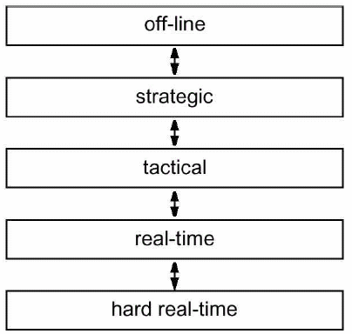
Temporal Decomposition
Distinguishes between processes that have varying real-time and non-real-time demands
Long response time
Global context
Short response time
Local context

Slide 12
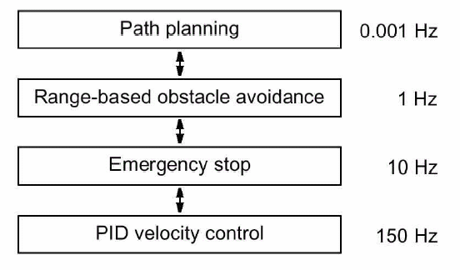
Temporal Decomposition
Example: Watchdog process

Slide 13

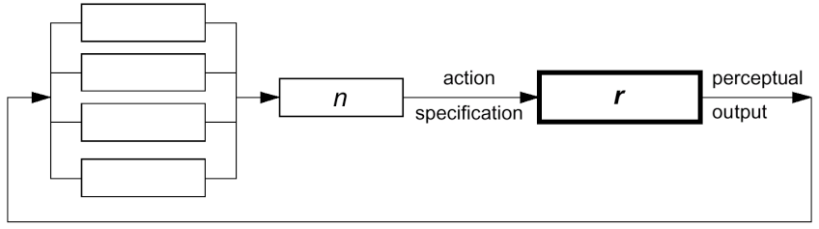
Control Decomposition
Models the way in which each module’s output contributes to the overall robot control outputs.
Pure serial decomposition:
Pure parallel decomposition:

Slide 14
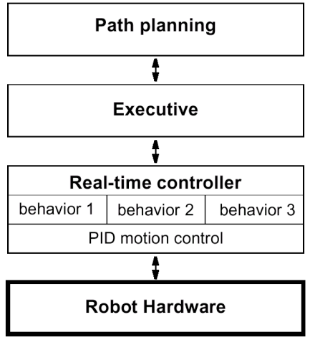
Example
Tiered mobile robot architecture based on a temporal decomposition
Strategic-level decision making
Controls the activation of behaviors based on commands from planner
Low level behaviors

Slide 15
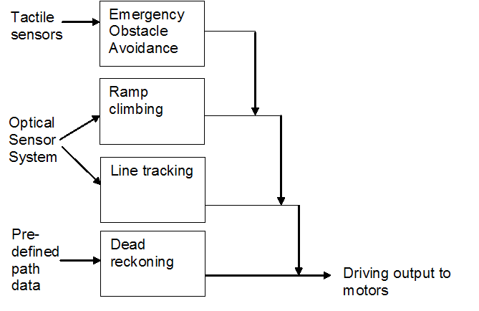
Subsumption Architecture
Formed using a collection of concurrent behaviors placed in layers.
The higher-level behaviors always, if triggered, subsume the output of lower behaviors and therefore have overall control.
Hard to have many layers, goals begin interfering with each other

Slide 16
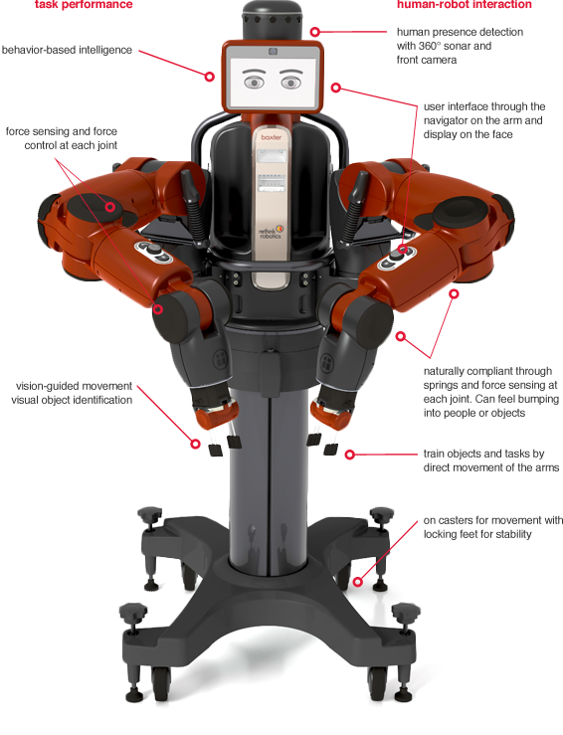

Rodney Brooks
Subsumption Architecture
iRobot (1990)
Rethink Robotics
  Baxter: 2012

Slide 17
Robot Components
Architecture Components
Perception
Planning
Obstacle avoidance
Stability control
Learning
Human-robot interaction
Short-term and long-term memory
Resources to be Controlled
Actuators
Communications
Chassis
Processor
Power
Payload

Slide 18
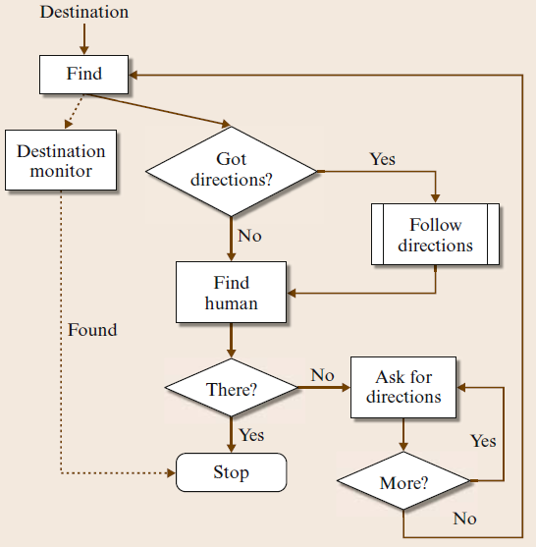
The Robot GRACE

Slide 19
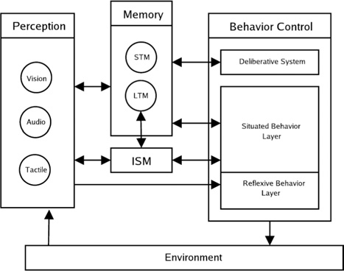
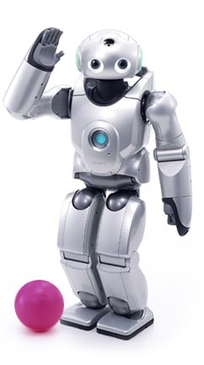
EGO Architecture for the Sony QRIO
Deliberative planning, control of sequential behaviors
Homeostatic behaviors
(sleep, rest)
Reactive behaviors
Internal State Module: nourishment, sleep, fatigue, vitality, etc

Slide 20
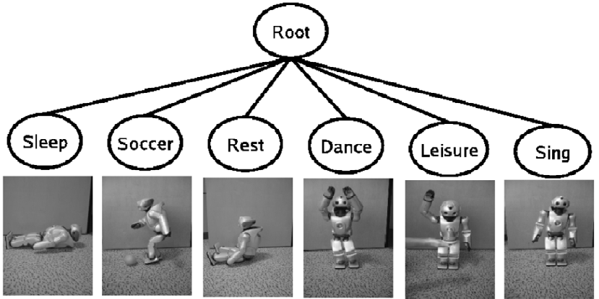

Slide 21
Behavior Selection
The behavior cycle rate: 2 Hz.
During each cycle, every behavior calculates an Activation Level which indicates the relevance of that behavior in the current situation.
  calculated based on the external stimuli and internal state of the robot, as well as intentional values provided by the Deliberative System.
Behavior selection occurs using a greedy policy:
  the behavior with the highest AL is selected first.
  other behaviors, from highest to lowest AL value, can then be selected for concurrent execution as long as their resource demands do not conflict with those already chosen.

Slide 22
Designing a Robotics Architecture
What are the tasks the robot will be performing?
  Are they long-term tasks? Short-term? User-initiated? Robot-initiated? Are the tasks repetitive or different across time?
What actions are necessary to perform the tasks?
  How are those actions represented? How are those actions coordinated? How fast do actions need to be selected/changed? At what speed do each of the actions need to run in order to keep the robot safe?

Slide 23
Designing a Robotics Architecture
What data is necessary to do the tasks?
How will the robot obtain that data from the environment or from the users?
What sensors will produce the data?
What representations will be used for the data?
What processes will abstract the sensory data into representations internal to the architecture?
How often does the data need to be updated?
How often can it be updated?

Slide 24
Designing a Robotics Architecture
What computational capabilities will the robot have?
What data will these computational capabilities produce?
What data will they consume?
How will the computational capabilities of a robot be divided, structured, and interconnected?
What is the best decomposition/granularity of computational capabilities?
How much does each computational capability have to know about the other capabilities?
Are there legacy computational capabilities (from other robots, other robot projects, etc.) that will be used?
Where will the different computational capabilities reside (e.g., on-board or off-board)?

Slide 25
Designing a Robotics Architecture
Who are the robot’s users?
What will they command the robot to do?
What information will they want to see from the robot?
What understanding do they need of the robot’s computational capabilities?
How will the user know what the robot is doing?
Is the user interaction peer to peer, supervisory, or as a bystander?

Slide 26
Designing a Robotics Architecture
How will the robot be evaluated?
  What are the success criteria? What are the failure modes? What is the mitigation for those failure modes?
Will the robot architecture be used for more than one set of tasks? For more than one kind of robot? By more than one team of developers?

Slide 27
References
Buede, Dennis M. The Engineering Design of Systems: Models and Methods, Second Edition. John Wiley & Sons. © 2009. Books24x7. http://common.books24x7.com/book/id_31904/book.asp
James Goodwin and Alan Winfield, “A Unified Design Framework for Mobile Robot Systems”, Workshop Proceedings of SIMPAR2008, Intl. Conf. on SIMULATION, MODELING and PROGRAMMING for AUTONOMOUS ROBOTS, Venice(Italy), 2008, November 3-4.
Siciliano, Khatib, Springer Handbook of Robotics, 2008.

Slide 29
ROS Overview
An open-source meta-operating system for robotics.
  Hardware abstraction,
  Low-level device control,
  Implementation of commonly-used functionality,
  Message-passing between processes,
  Package management.

Slide 30
ROS Overview
Runs on Unix-based platforms (Ubuntu).
Experimental on Mac OS X.
Partial functionality on Microsoft Windows.

Slide 31
ROS
Peer-to-peer
Multi-lingual
Tool-based
Thin
Free and open-source

Slide 32
ROS Nomenclature
Nodes are processes that perform computation.
Nodes communicate with each other by broadcasting 1-way messages.
A node sends a message by publishing it to a given topic.
Services are used for synchronous transactions.
To support collaborative development, the ROS software system is organized into packages.

Slide 33
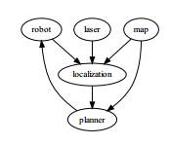
Packages
Self contained “out of the box” algorithms
Start-stop all at once

Slide 34
Rapid development
Easy to test & debug
Easy to share (Modularity)
Platform interoperability
But,
Constantly changing
Lots of imperfect code out there

Slide 35
References
Roland Siegwart, Illah R. Nourbakhsh, and Davide Scaramuzza. ”Introduction to Autonomous Mobile Robots,” 2nd ed., 2011.
Quigley, Morgan, et al. ”ROS: an open-source Robot Operating System.” ICRA workshop on open source software. Vol. 3. No. 3.2. 2009.http://pub1.willowgarage.com/~konolige/cs225B/docs/quigley-icra2009-ros.pdf
http://www.ros.org
http://ros.org/wiki/ROS/Introduction
http://www.ros.org/wiki/ROS/Tutorials
Notes:
Placing virtually all complexity in libraries, and only creating small executables which expose library functionality to ROS, allows for easier code extraction and reuse beyond its original intent. As an added beneﬁt, unit testing is often far easier when code is factored into libraries, as standalone test programs can be written to exercise various features of the library.

Slide 37
Next Up
(Simple) Perception
http://vision.in.tum.de/data/software/tum_ardrone
  http://www.youtube.com/watch?v=g8O5RBcwmjY

Slide 38
Simple Vision
How would I find the red ball?

Slide 39
Simple Vision
How would I find the red ball?
What if it’s moving?

Slide 40
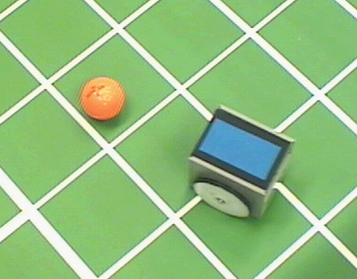
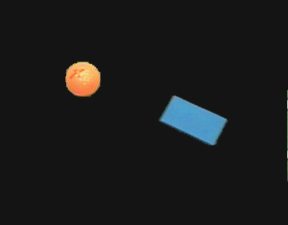
Color Tracking Sensors
4.1.8
Motion estimation of ball and robot for soccer playing using color tracking

