Slide 2
Lab
Often open past 9pm (building may close at 11pm)
Can also stay after class
Would having a scheduled lab period have helped?
Lab 3, Homework 1 posted
Departmental talk at 1:30
Sorry, won’t be at office hours

Slide 3
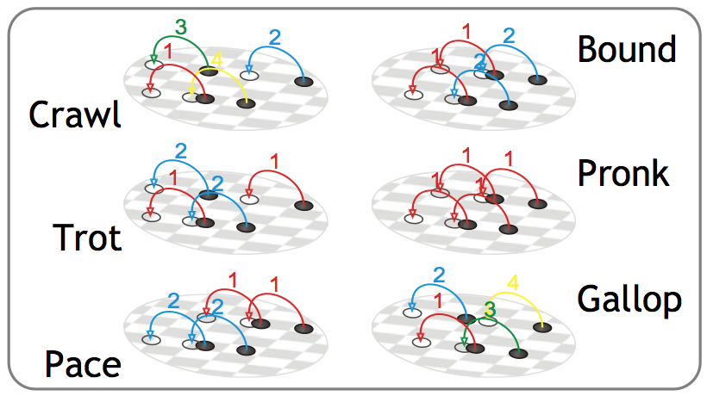
Gaits

Slide 4
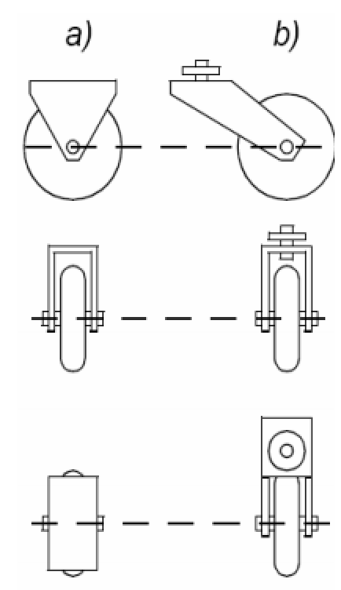
Wheel Designs
a) Standard wheels
2 DOF
b) Castor wheels
2 DOF

Slide 5
Configuration: complete specification of the position of every point of the system. Position and orientation. Also, called a pose
Configuration space: space of all possible configurations
Workspace: the 2D or 3D ambient space the robot is in.

