Slide 2
Robotics Club: 5:30 this evening
How are things going?

Slide 3
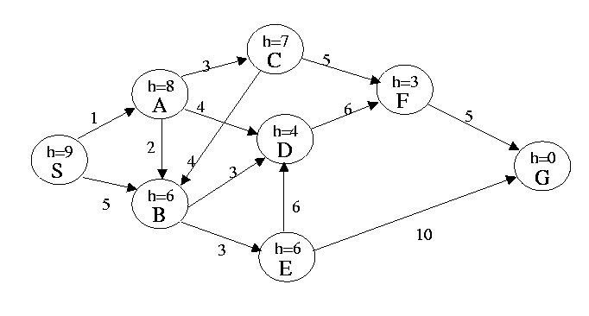
In this problem the start state is S, and the goal state is G. IGNORE the heuristic estimate, h, and the transition costs next to the edges. Assume that ordering is defined by, and ties are always broken by, choosing the state that comes first alphabetically.
What is the order of states expanded using Depth First Search? Assume DFS terminates as soon as it reaches G.
What is the order of states expanded using Breadth First Search? Assume BFS terminates as soon as it reaches G.
Notes:
SABDFG
SABCDEFG

Slide 4
In this problem the start state is S, and the goal state is G. The transition costs are next to the edges. IGNORE the heuristic estimate, h. Assume that ordering is defined by, and ties are always broken by, choosing the state that comes first alphabetically.
What is the order of states expanded using Uniform Cost Search? Assume algorithm terminates when reaches G.
Notes:
SABCDEFG

Slide 5
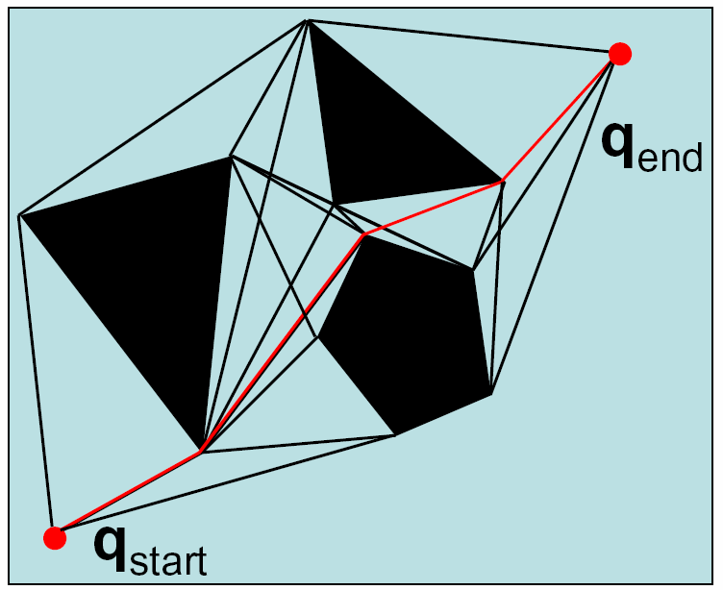
Visibility Graph Road Map: Exact Decomposition

Slide 6
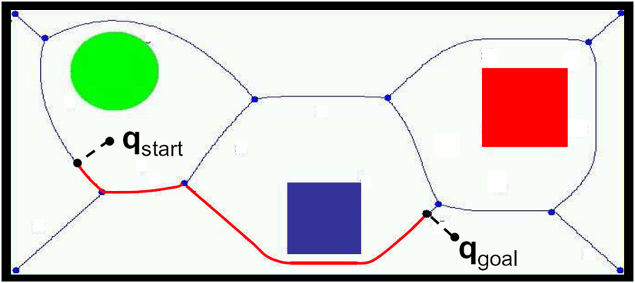
Voronoi Diagram Road Map: Exact Decomposition

Slide 7
Occupancy Grid, accounting for C-Space Approximate, Fixed Cell Decomposition
start
goal

Slide 8
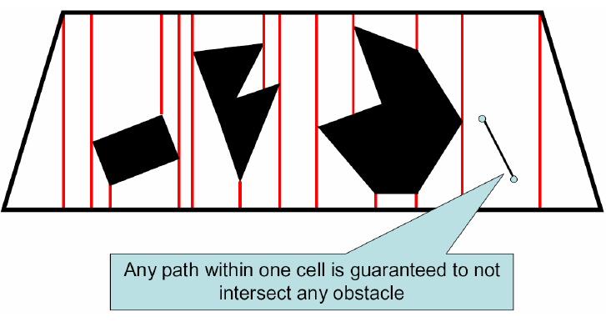
Exact Cell Decomposition
How would this be used?

Slide 9
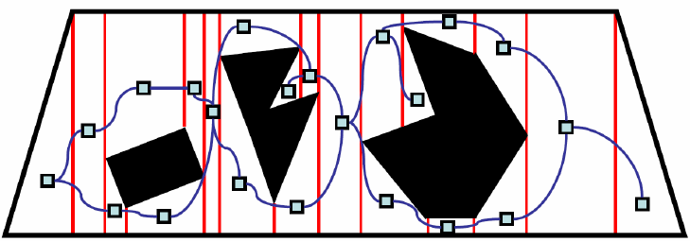
Exact Cell Decomposition
Identify adjacent cells

Slide 10
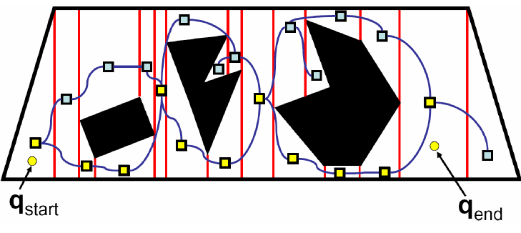
Exact Cell Decomposition
Plan over this graph
How can we improve the path?

Slide 11
Example of Adaptive Decomposition
Quadtrees

Slide 12
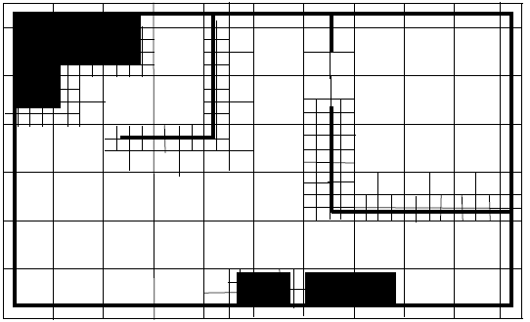
Example of Adaptive Decomposition
Quadtrees
Each internal node has 4 children
Recursively sub-divide space into quadrants

Slide 13
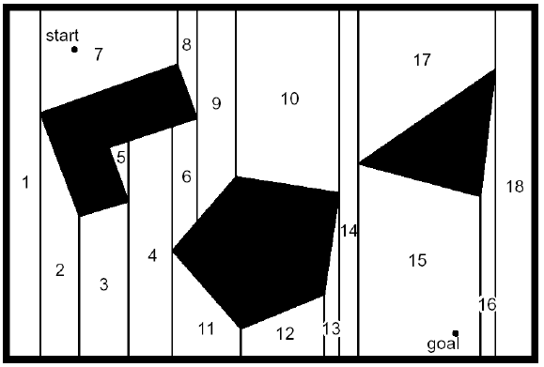
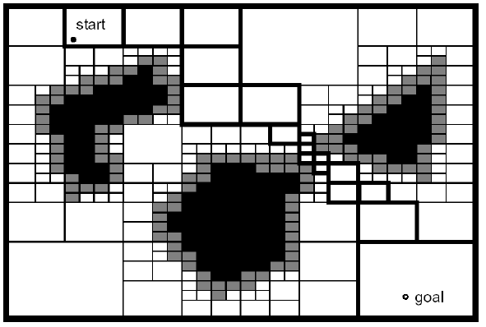
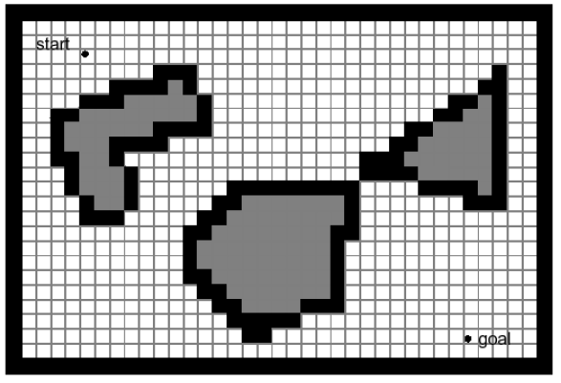
Exact vs. fixed vs. adaptive
Pros and Cons?

Slide 14
Considerations
Difficulty in constructing map
Computational complexity
Planning over map
Constructing map
Map Accuracy
Memory Needed

Slide 15
Kinematics
Move were you want to go
Navigation
Given a Map, and Path planning: Decide where you want to go, and then use Kinematics
Maps
Representation: Turn the real world into a map I can plan over
Localization
Given a map, how do I know where I am?
Map building
Oh man, how do I construct a map? Well, it probably depends on where I am and how I move….

Slide 16
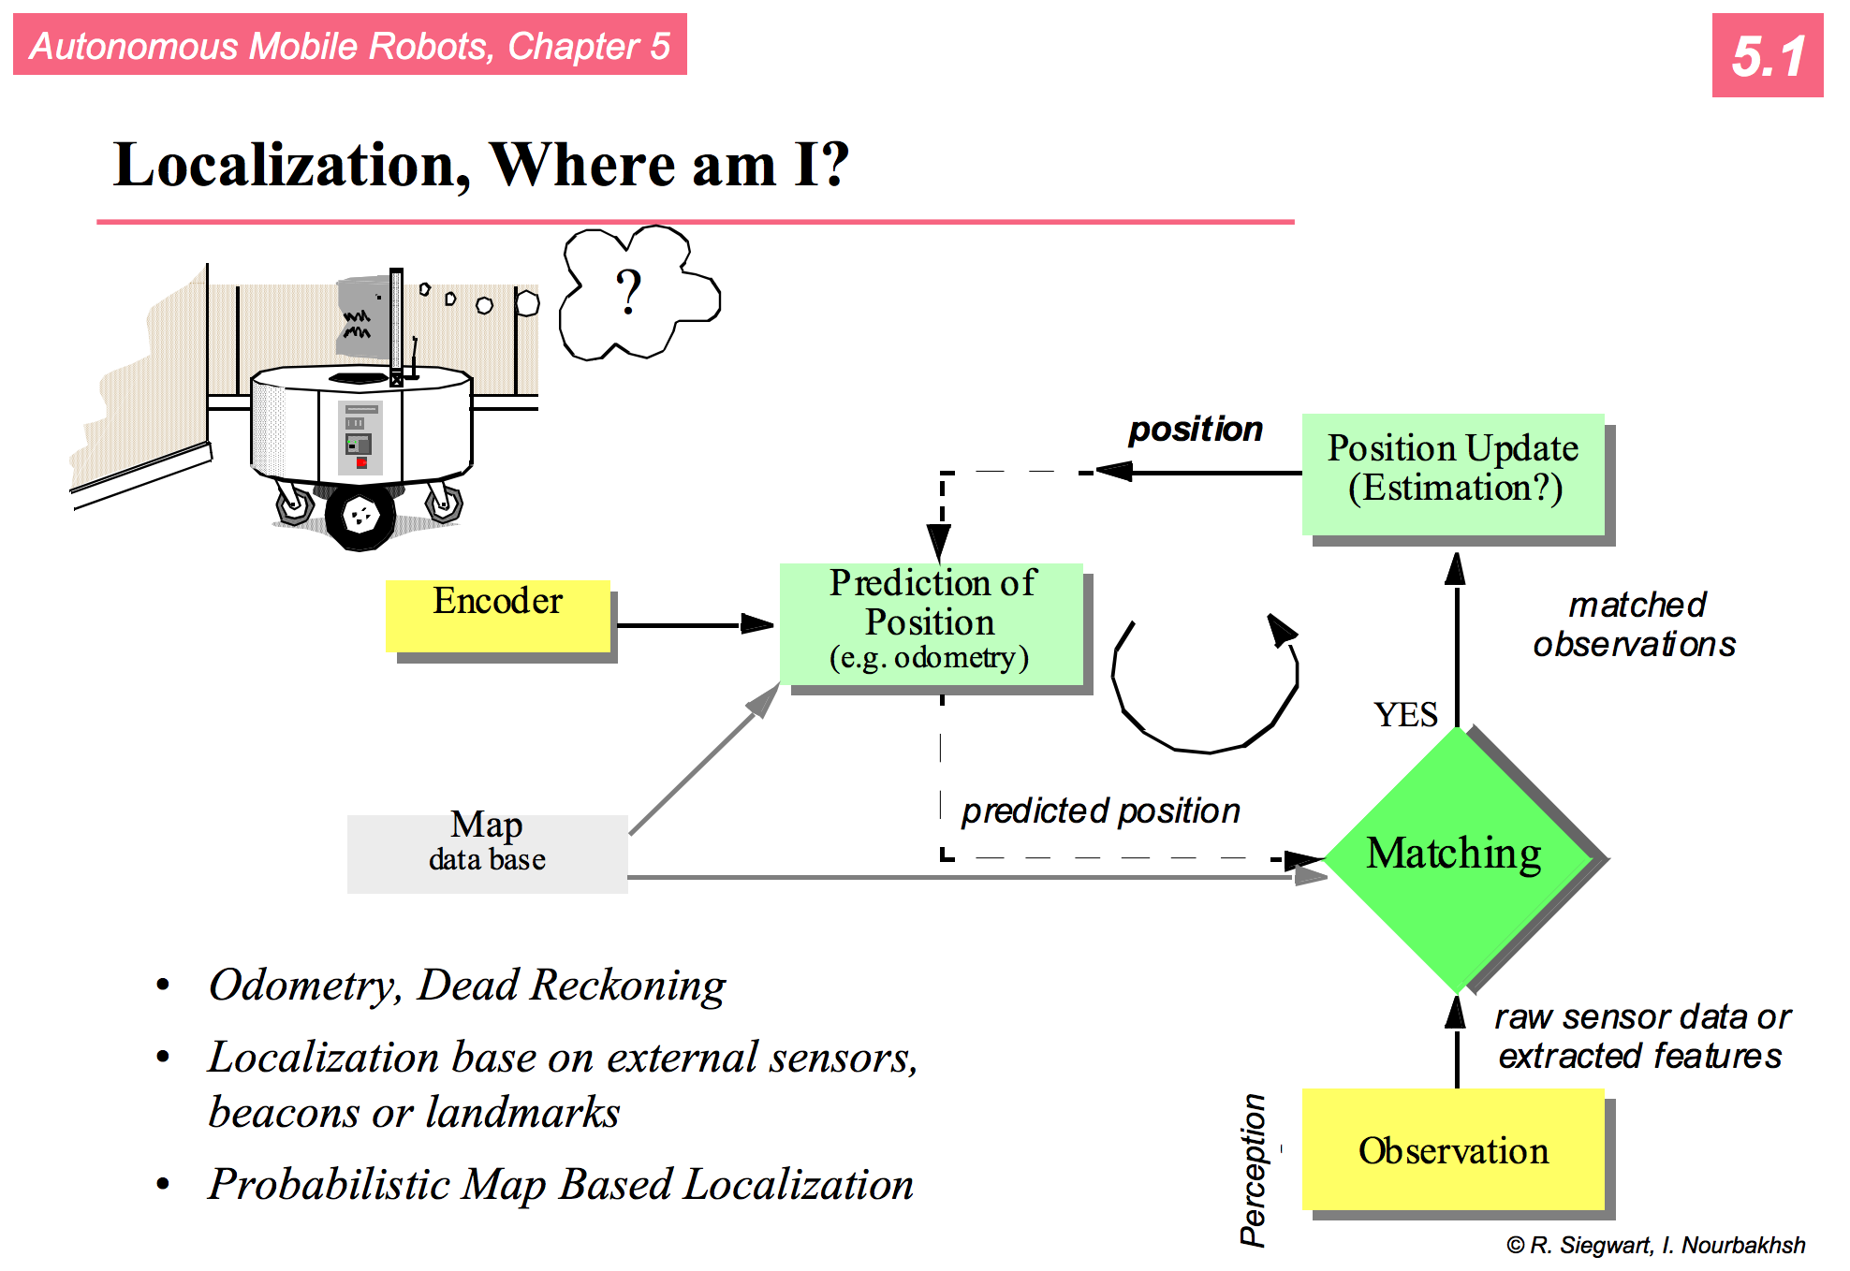

Slide 17
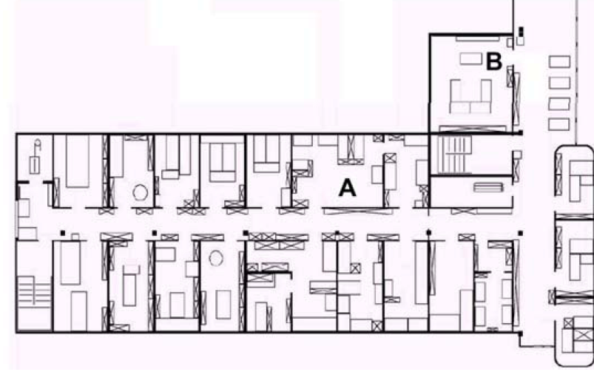
How to navigate between A and B?
Two components to this task:
Navigation without hitting obstacles
Detection of goal location
Possible by following always the left wall
How to detect that the goal is reached?
“behavior based navigation”
It can work in some environments but not in all

Slide 18
How to navigate between A and B?
Map based navigation relies on a map
Assuming that the map is known, at every time step the robot has to localize itself in the map.
How?
If we know the start position, we can use wheel odometry or dead reckoning.

Slide 19
Odometry and Mapping
Create a map as the robot is exploring the environment.
If we assume that our odometry is perfect, could get something like this:
Can’t trust odometry so we must localize as we’re mapping.

Slide 20
Challenges
Effector noise / Odometry Error
Distance movement estimation
Turn error: turning estimation
Drift Error: difference in error of wheels
Sensor noise
False positive readings, fall negative readings, noisy readings
Sensor aliasing
Multiple locations appear the same to the sensors

Slide 21
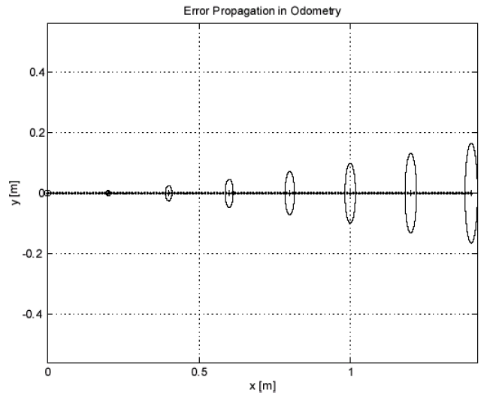
Simple error model from kinematics

Slide 22
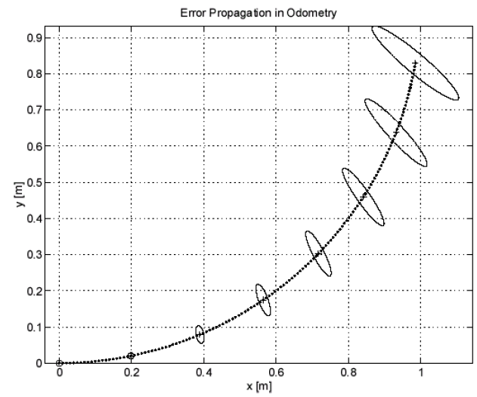
but now add in turning…

Slide 23
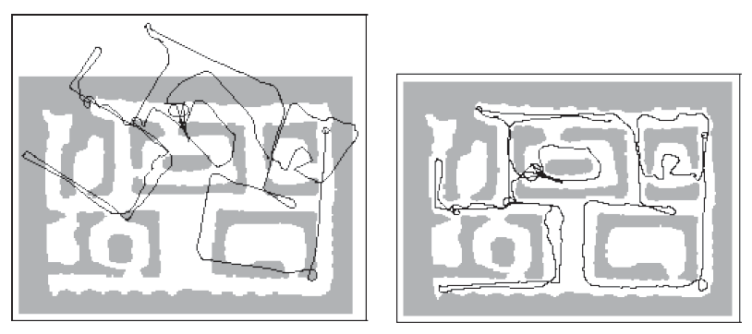
and this leads to things like
(Dieter Fox @ CMU)

Slide 24
Localization
Two types of approaches:
Iconic : use raw sensor data directly. Match current sensor readings with what was observed in the past
Feature-based : extract features of the environment, such as corners and doorways. Match current observations

Slide 25
Continuous Localization and Mapping
Time
Initial Map
Global Map

Slide 26
Continuous Localization and Mapping
Time
Sensor Data
Local Map
Global Map
Matching
Registration
$\left(x,y,θ\right)$ offsets to correct odometry

Slide 27
Continuous Localization and Mapping
Time
Local Map
Global Map
Matching
Registration
$\left(x,y,θ\right)$ offsets to correct odometry

Slide 28
Continuous Localization and Mapping
register
global map
match and score
sensor data
construct local map
local map
best pose

Slide 29
Continuous Localization and Mapping
register
global map
match and score
sensor data
construct local map
local map
best pose
encoder data
pose estimation
k possible poses

Slide 30
Matching
X
Where am I?
Local Map
probabilities
Global Map

Slide 31
Matching
®
Where am I on the global map?
Local Map
obstacle
Global Map















®


…

®


…








…


















Examine different possible robot positions.

Slide 32
This sounds hard, do we need to localize?
http://www.youtube.com/watch?v=1FKMniE_q1Q

Slide 33
Matching and Registration
Collect sensor readings and create a local map
Estimate poses that the robot is likely to be in given the distance traveled from the last map update
In theory k is infinite
Discretize the space of possible positions (e.g. consider errors in increments of 5º)
Try to model the likely behavior of your robot. Try to account for systematic errors (e.g., robot tends to drift to one side)

Slide 34
Matching and Registration
Collect $n$ sensor readings and create a local map
Estimate $k$ poses $(x,y,θ)$ that the robot is likely to be in given the distance travelled from the last map update
For each pose $k$ score how well the local map matches the global map at this position
Choose the pose with the best score. Update the position of the robot to the corresponding $(x,y,θ)$ location.
What if you were tracking multiple possible poses.
How would you combine info from this with
previous estimate of global position + odometry?

Slide 35
Matching and Registration
Collect $n$ sensor readings and create a local map
Estimate $k$ poses $(x,y,θ)$ that the robot is likely to be in given the distance travelled from the last map update
For each pose $k$ score how well the local map matches the global map at this position
Choose the pose with the best score. Update the position of the robot to the corresponding $(x,y,θ)$ location.
Registration: update the global map. One possible way:$global\left[i\right]\left[j\right]=\frac{global\left[i\right]\left[j\right]+local\left[i\right][j]}{2}$

Slide 36
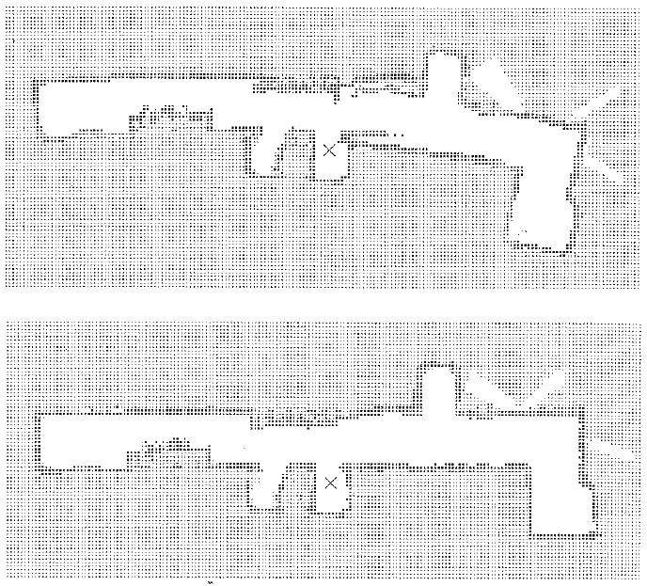

Slide 37
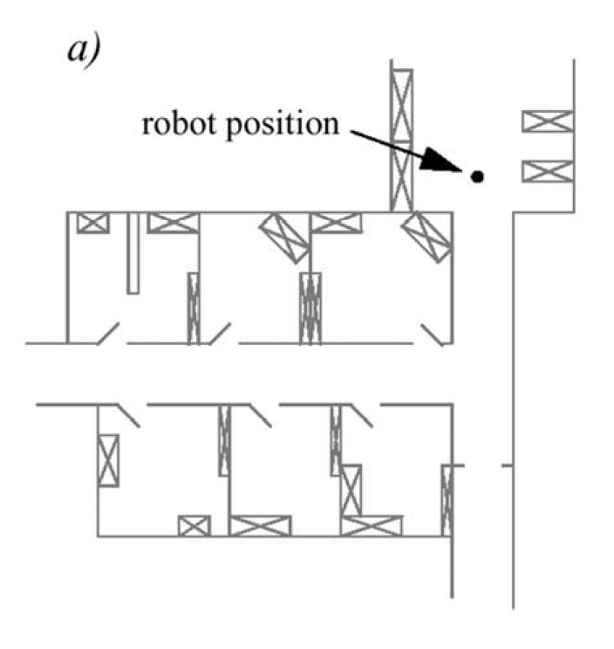
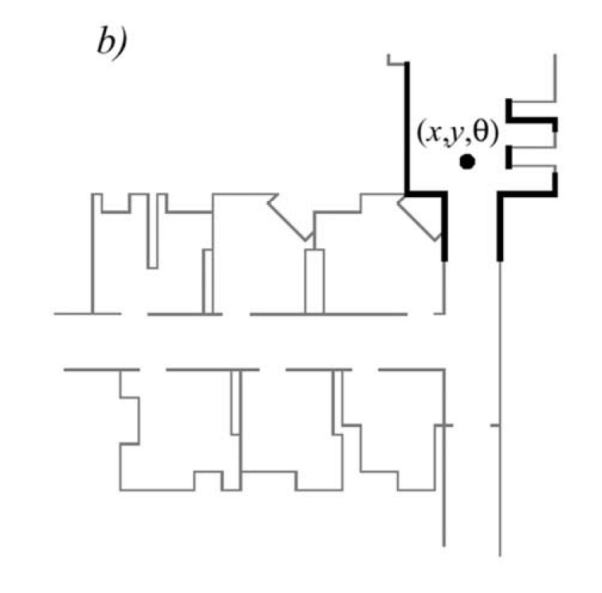
Representations
line-based map (~100 lines)

Slide 38
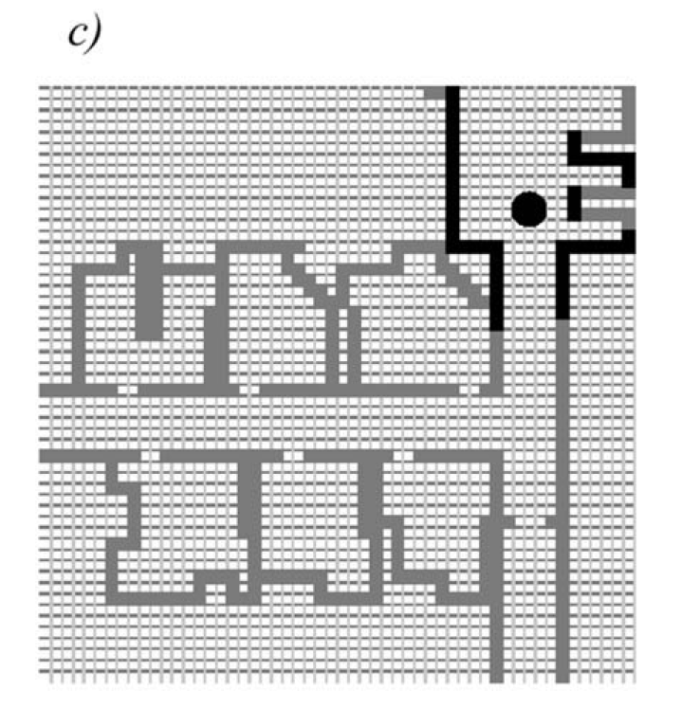
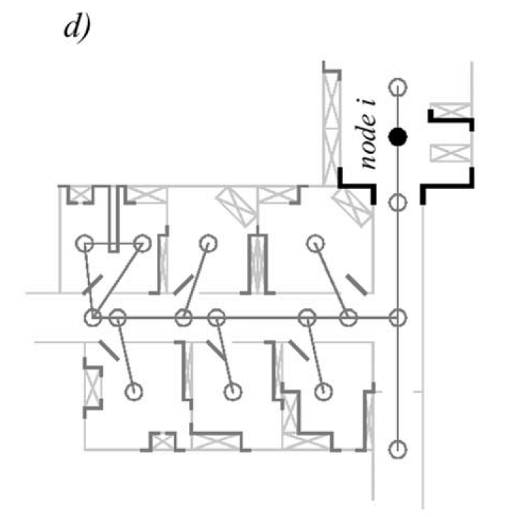
Representations
One location vs. location distribution
Grid-based map (3000 cells)
Topological map (50 features, 18 nodes)

Slide 39
Feature-Based Localization
Extract features such as doorways, corners and intersections
Either
Use continuous localization to try and match features at each update
Use topological information to create a graph of the environment

Slide 40
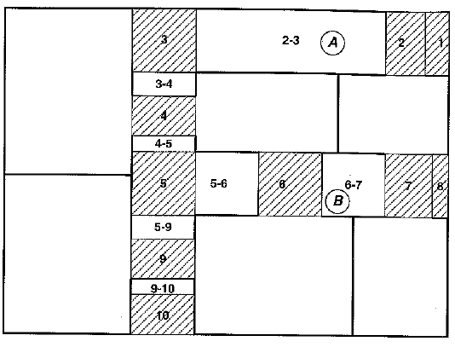
Topological Map of Office Building
The robot has identified 10 doorways, marked by single number.
Hallways between doorways labeled by gateway-gateway pairing.

Slide 41
Topological Map of Office Building
What if the robot is told it is at position A but it’s actually at B. How could it correct that information?

Slide 42
Localization Problem(s)
Position Tracking
Global Localization
Kidnapped Robot Problem
Multi-Robot Localization

Slide 43
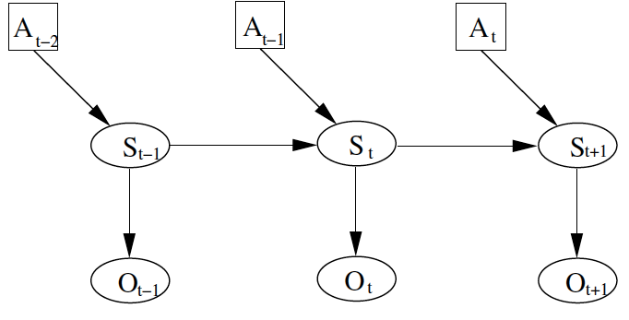
General approach:
A: action
S: pose
O: observation
Position at time t depends on position previous position and action, and current observation

Slide 44
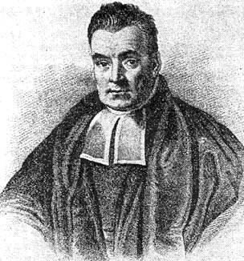
Pose at time t determines the observation at time t
If we know the pose, we can say what the observation is
But, this is backwards…
Hello Bayes!

Slide 45
Quiz!
If events a and b are independent,
p(a, b) =
If events a and b are not independent,
p(a, b) =
p(c|d) = ?
Mattel
1992

Slide 46
Quiz!
If events a and b are independent,
p(a, b) = p(a) × p(b)
If events a and b are not independent,
p(a, b) = p(a) × p(b|a) = p(b) × p (a|b)
p(c|d) = p (c , d) / p(d) = p((d|c) p(c)) / p(d)

Slide 47
Bayes Filtering
Want to have a way of representing uncertainty
Probability Distribution
Could be discrete or continuous
Prob. of each pose in set of all possible poses
Belief
Prior
Posterior

Slide 48
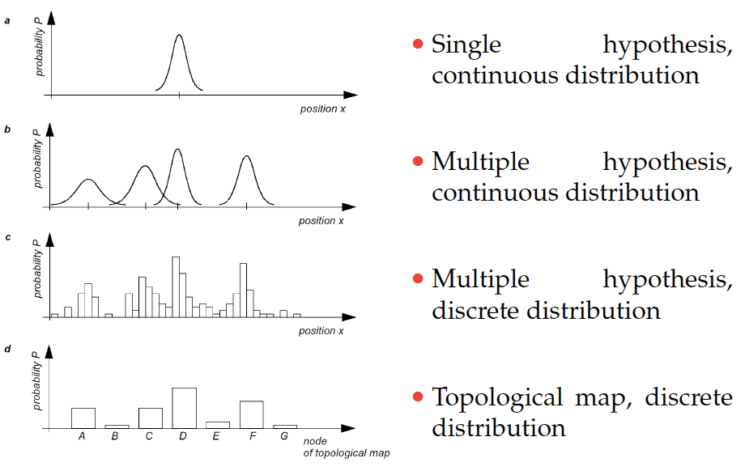
Models of Belief

Slide 49
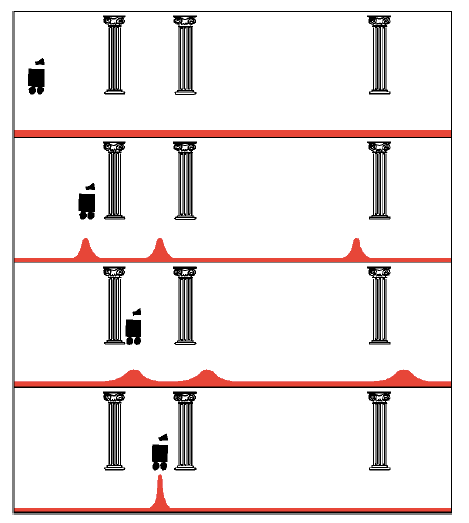
Uniform Prior
Observation: see pillar
Action: move right
Observation: see pillar

Slide 50
Modeling objects in the environment
http://www.cs.washington.edu/research/rse-lab/projects/mcl

Slide 51
Modeling objects in the environment
http://www.cs.washington.edu/research/rse-lab/projects/mcl

